Slide 1
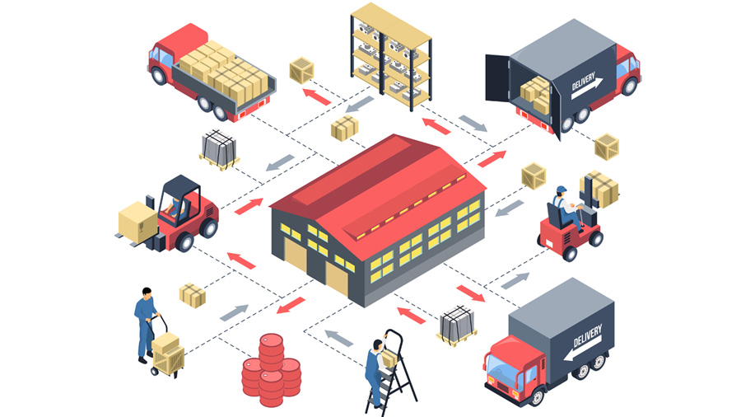
User Depot Module (UDM)
Presented by:
D.L.N. PRABHAKAR-Dy.CMM-IC-SCR

Slide 2
Genesis
UDM was by Developed by CRIS as per mandate from Railway Board
Intends to computerize Material Management at Consignee’s end (All Departments)
Fully integrated with iMMS & IREPS

Slide 3
UDM Implies → User Depot Module develop by CRIS-NDLS.
Supply chain of Materials Management Department is never complete without Digitalization of Depots by not implementing UDM.
UDM has led to optimization and traceability of materials usage resulting in improved Asset Maintenance and transformational changes from manual working to digital working environment. Further, by implementing this module, an expenditure control is achieved, due to which all users are being encouraged to work on this UDM platform for any transactions made by them.

Slide 4
WHAT is UDM?
What can be done in UDM?
Creation of Computerized Ledgers
Receipt of material
Issue of material to different stake holders
Generation of digitally signed Consignee Receipt Note (CRN) / Consignee Receipt
Certificate (CRC)
Provision for Receipt & Issue on Loan & Assistance basis
Rejection Handling both Initial Rejection as well as Warranty Rejection

Slide 5
More about UDM?
What can be done in UDM?
Stock Sheet Management
Stock Verification (Accounts as well as Departmental)
Generation of Daily Material Transaction Report (DMTR)
Inventory Management
And many more….

Slide 6
Intended benefits:
Computerization of the entire Supply Chain
Optimization of material procurement leading to cost reduction & economy
Improved Level of Service to internal as well as external customers
Traceability of material usage leading to improved Asset Maintenance
Real time information exchange (incl. Stock Position) on pan-India basis
Enhanced efficiency & transparency

Slide 7
UDM Capabilities
Creation of Computerized Ledgers
Receipt of material:
Directly from Vendors or Contractors against Stores Purchase Orders / GeM Orders / Works Contracts / Cash Purchase / Imprest / Others
From Other User Depots & Consignees
From Stores Depots against S-1313 Demand / S-1830 (Imprest) / Non-Stock R-Notes / Sale Issue Notes
Against Book Transfer
Returned Stock Receipts from Field
Unconnected Receipts
Shop Manufactured material Receipts

Slide 8
UDM Capabilities
Contd……… 1
Generation of digitally signed Consignee Receipt Note (CRN) / Consignee Receipt Certificate (CRC)
Issue of material:
To End User i.e. Ultimate User
To other User Depots/Consignees
To Contractors
On Book Transfer
To Stores Depots on Advice Note
To Purchasers as Scrap Deliveries against Auction Sale
Provision for Receipt & Issue on Loan & Assistance basis

Slide 9
UDM Capabilities
Contd……… 2
Placement of Demands on User Depots & Demand Management
Generation of computerized Gate Pass for the material issued
Placement of S-1313 & Imprest (S-1830) Demands on Stores Depots
Provision for Codification for Non-Stock Items
Facilitates issue of material on FIFO (First In First Out)
Integration with RITES & RDSO Inspection Database
Linkage with IRPSM Work ID while issuing material
Rejection Handling both Initial Rejection as well as Warranty Rejection
Stock Verification (Accounts as well as Departmental)
Stock Sheet Management
Contd…

Slide 10
UDM Capabilities
Contd……… 3
SMS alert to user when Stock falls below Threshold Limit
Provision for uploading Image of item
Transactions with Non-Computerized User Depots & Consignees
Generation of Adjustment Memos for raising Debits on other User Depots
Generation of Daily Material Transaction Report (DMTR)
Inventory Management, Consumption Analysis
Warranty Period / Shelf-Life based Analysis
Vendor-wise / Make-wise Analysis
Provision of MIS & Exception Reports (downloadable in Excel)
Transactions in digitally secured environment

Slide 11
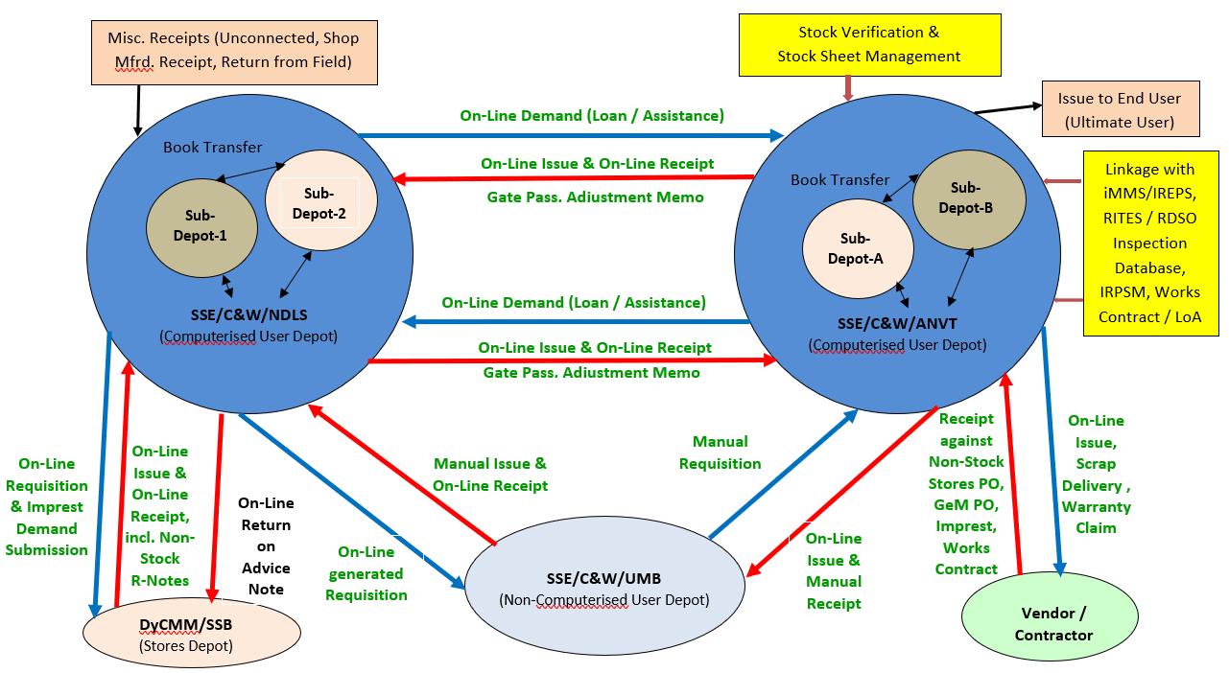

Slide 12
Status
After Trials in WR & SCR, Railway Board directed for roll-out of UDM in all Consignees / User Depots of all Deptts. on Indian Railway on 14.09.2020
Pan-India Launch by CEO & Chairman/Railway Board on 26.11.2020
1st Phase: Zonal Railways, CORE, NF (Con)
2nd Phase: PUs, Other Units [Rly. Bd. directions issued on 05.01.2021]
AGMs/PCMMs/ADRMs/CWMs are coordinating implementation of UDM
Presently all Consignees in SCR are on-boarded and Transactions done only through UDM.
More than 1.28 Lakh Transactions valuing > Rs.1200 Crores done
Implementation being closely monitored by GM & Railway Board
Very encouraging user feed-back

Slide 13
Way Forward
Facility for placement of Non-Stock Demands in UDM
Integration with other applications like:
IPAS (Integrated Payroll & Accounting System)
SLAM (Software for Loco Asset Management)
CMMS (Coaching Maintenance Management System)
FMMS (Freight Maintenance Management System)
WISE (Workshop Information System)
TMS (Track Management System) etc

Slide 14
Requirements
PC / Laptop / Printer
Internet Connectivity
Minimum Class-2 Digital Signature Certificate (DSC) [Same DSC being used for iMMS / IREPS / e-Office / SPARROW / e-filing of IT Return can be used for UDM also]
Basic knowledge of Computer
Consignee Code of User
Email ID of User (@gov.in or any domain)
Mobile No. of User

Slide 15
On-boarding on UDM
Trial Site of UDM for Training / Orientation (www.trial.ireps.gov.in):
Few Trial Users are created by CRIS for hand-on training / orientation
Officers having Trial account to create further Users in their Unit for Trial
CRIS’ Trial DSC also given to nominated Trial users
Production Site of UDM for Actual Live Working (www.ireps.gov.in):
All Deptts./Units of IR are already using IREPS for tendering etc.
Officers can access UDM using their existing user-ID / Password of IREPS with their own DSC (iMMS ID is different & cannot be used for UDM)
IREPS Admins (HoDs / CWMs / Branch Officers etc.) of respective Deptts./ Units to create users for live run of UDM
IREPS Admin List already shared with PCMMs of Railway

Slide 16
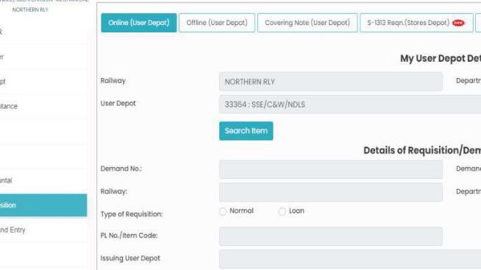

Slide 17
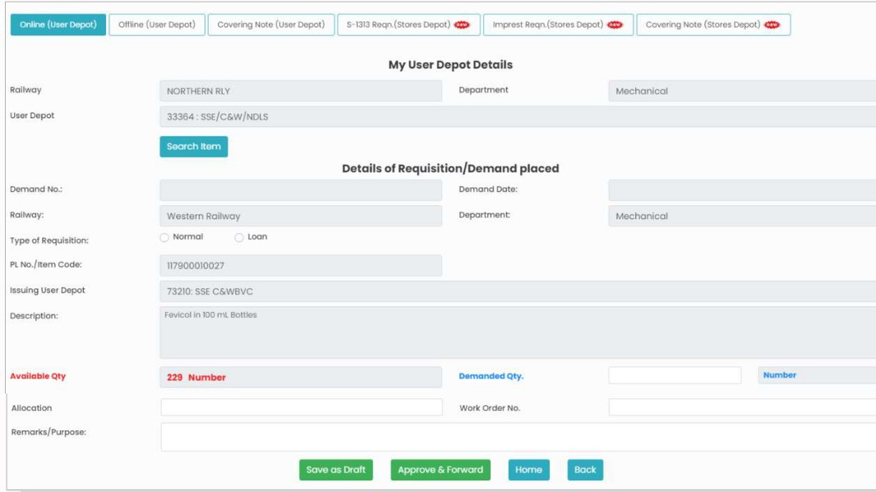

Slide 18
Hand-Holding
Weekly WebEx Training/Orientation Sessions for UDM by CRIS
Very exhaustive User Manual for UDM shared with users
User Manual also available on IREPS Site → Learning Centre Link
Ready-Reckoner / Hand-out for UDM also provided to user
IREPS Help Desk Service on Telephone No.: 011-23761525 (10 Lines - Timings: 08.00 AM to 07.00 PM on all working days)
Users can use On-line Help using Web-Queries (Ask a Question Link on IREPS Website → Help Desk Link. (Query ID will be generated for each query submitted. Reply will be sent by e-mail and the same can also be viewed by clicking on View Reply to Question Link)

Slide 19


