Slide 1
Stores Budget
Budgeting is a process of planning activities of an organization’s responsibility centers for a future period (usually the next year).
Further, the Budget also enables,
  -Revised planning activities for current year, and expressed in quantitative terms (usually monetary),
  -Covering a specified period of time (usually one year).
Chapter XXXI of the Stores Code deals with procedure and preparation of Stores Budget.

Slide 2
Stores Budget
The Stores Budget for the ‘ensuing year’ and the Revised Estimates for the current year should be prepared as per the prescribed format by the COS duly vetted by the Associate accounts officer and submitted to Railway Board by 23rd December of each year. Now the dates advanced due to advancement of Genl. Budget.(intimated time to time)
The budget in two parts, and is consisting for both procurement of ‘Fuel oil’ and other ‘general purpose stores’ for the consumption of Zonal Rly activities. Guidelines are issued from time to time by the Railway Board and have to be followed for making the Budget Estimates incorporating the special features.
The budget estimates are submitted along with Annexures A, B and C viz., Statement showing Major Groups of Stores, Analysis of balance Stores in Stock and Assets procured on account of acquisition, construction and replacement.
The above analysis is to ensure optimum closing balance.

Slide 3
Stores Budget
Opening Balance:
The OB for the ensuing period will be an estimated figure made up of:
  the estimated book value of the stores expected to be in stock at the end of current year,
  the estimated net result of outstanding balance under stores suspense heads of Purchases Imported, indigenous, sales etc., and
  the amount expected to be outstanding in the Stock Adjustment Account for the year are closed.
It is to be ensured that all out efforts are made for estimation of balances to the optimum level and the estimates are prepared in 000s of rupees.
Actuals for the last year BG for the current year RE and BE for the ensuing year projected realistically.

Slide 4
Stores Budget
Estimated Debits: These consist of:
Stores for works are estimated based on the divisional estimates of works proposed in the ensuring year.
Stores for General purpose are estimated throw forward from the previous year, Indents for the current year, Less estimated throw forward in the next year. Actually this is the last item of to be budgeted after posting debits and credits being a balancing figure.
Receipts from the manufactured stores are to be provided for duly matching the targeted out turn of components in the shops.
Materials returned from works left over and released materials.
Other debits consisting items arrived out of SA Account which also include the value of fabricated stores based on the estimates.
Deduct issues with in the Demand

Slide 5
Stores Budget
Estimated Credits: These consist of
Issue to works are estimated based on the matching grants available in the divisions/units and based on the Indents on hand.
Issues to Capital to be budgeted based on the matching grant available in the WMS grants against which work orders are issued.
Issue of Misc.Adv.Capital represents the issues of stores for fabrication etc.
Issues to Revenue (PU 27) Stores for use on repairs and maintenance of operational work. AACs worked out for last 3 years is the criteria and after considering the special circumstances of each year this item is estimated.
Sales and transfers No accurate estimate can be made. However based on the trend on movement of stores and expected sales.

Slide 6
Stores Budget
Closing balance consist of
Stores in Stock balance ideally would be 40% of the Average issues per month of ordinary stores during the year plus such cost of emergency stores.
Outstanding Stores suspense is corresponding to the similar item under opening balance and should be as low as possible.
Budget allotment This would be the total of debits during the year. A brief narrative explanation of the difference between the OB and CB should be given and special features in the estimates should be brought out clearly with full explanations and the amount involved.

Slide 7
Stores Budget
Progress of Debits and Credits in the Budget
Once the grant is received the complete statement of Debits(Receipts) and Credits(Issues) are prepared and Net grant worked.
The progress under each should be watched by the Accounts Officer to ensure that there is no accumulation of stocks at the end of the year.
Exact allotment for each head, actuals to end of each month, approximate actuals for each month(forecast), both for current month and for the to end of the months are analysed to ensure that issues are in accordance with the total plan of the system.
In the case of variations at each budget stage the same are reported to COS to ensure revisions to Grants are sought.

Slide 8
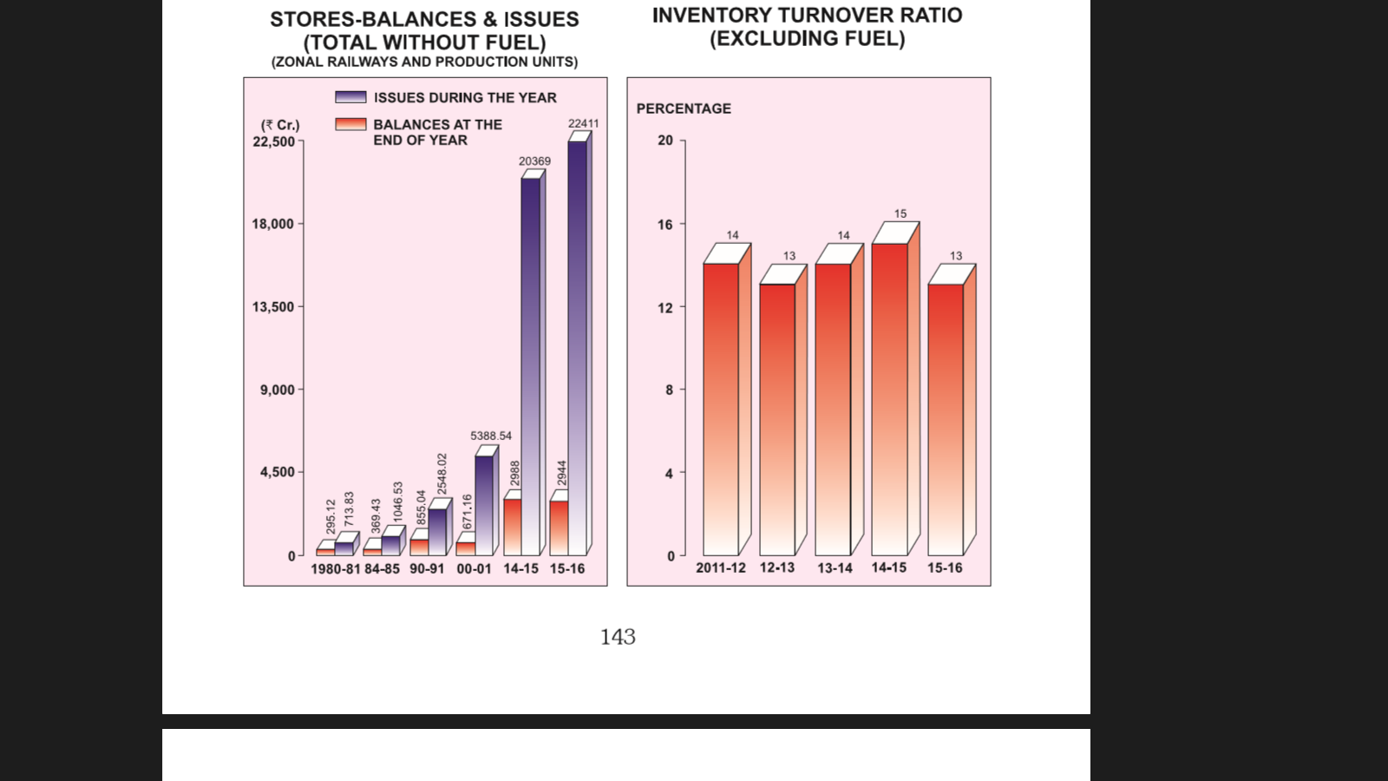
Volume of Inventory

Slide 9
Stores Budget - Format
Railway Stores Transactions for ……..
Debits
Particulars | Actuals 2013-14 | BG 20 14-15 | RE 2014-15 | BE 2015-16
-Balance O/B: A1. Stores Other than Fuel Stores in Stock Scrap Other than scrap Total for stores in stock Stores in Transit O/s in SA A/c scrap other than scrap O/s in SA A/c O/s in Pur. Susp O/S in Sales Susp scrap other than scrap Total for o/s sales susp. Total for Stores

Slide 10
Assessment of Closing/Opening Balance
Balances for Fuel Oil: Generally the balance is to be maintained as per the physical quantity of the 5 days consumption. It is also to be considered for the purpose fixing the quantities the estimated GTKMS for the ensuring year on account of changes in the traction due to policy of ‘electrification of IR’ and gradual withdrawing of Diesel Engines.
Balance for GP Stores: Generally 15 days consumption of stores of all stock items to be considered for the purpose of maintaining of continuity of stock issues.
Further, it is to be considered that special changes anticipated during the current year and also in the ensuring year reflecting changes in the balances and pattern of consumption due to integration of IT utilities.
Now with the introduction of iMMS module connecting the all depots it is necessary that balances for minimum quantity and Buffer Stocks should come down drastically.

Slide 11
Stores Budget - Format
Railway Stores Transactions for ……..
Credits
Particulars | Actuals 2013-14 | BG 20 14-15 | RE 2014-15 | BE 2015-16
E. Issues during year I to Capital – Mfg.Suspense ii. To Works iii. To Misc.Advance – Capital iv.a. to Stores – for issue to Coach builder iv.b.to Stores for issue to Wagon builder v.To Revenue Stores (other than Fuel) vi.a. to Sales –Scrap vi.b.to Sales: other than Scrap vi.c.to Inter-Rly Transfer: Scrap vi.d.to Inter-Rly Transfer: Other than scrap vi.e to Sales/Inter Railway Transfer (vi.a +vi.b+vi.c+vi.d) vii. CENVAT Credits viii.Total Issues – Stores (Other than fule)(i+ii+iii+iv.a+v+vi.e+vii)

Slide 12
Assessment of Credits – 1/3
Issues to 'Works' (Item I to III of the Statement)-The expenditure on stores purchased for specific 'works' that can be identified as initio as such, should be debited directly to the 'Works' concerned and not passed through the general stores suspense head. The figures on this accounts should not, therefore, be included.
Estimates for stores required for 'Works' which cannot be identified as stated above should be called for from the Divisional Officers/Heads of Departments by the Controller, of Stores and incorporated against the relevant items.
The concerned Heads of Departments sometimes makes modifications in the budget, estimate submitted to them by the various divisions owing to changes in the programme of works. The effect on the Stores Budget of these modifications should be intimated to the Controller of Stores as soon as they are carried out in the Works programmes finally submitted to the Railway Board.

Slide 13
Assessment of Credits – 2/3
Issue to capital Manufacture Suspense.-These estimates should be initially prepared by the department entrusted with the manufacture and repair operations in consultation with the respective Accounts Officers and furnished to the stores Department for incorporation in the Stores Budget.
The value of materials budgeted for under this head should represent the value of materials likely to be drawn by the workshops during the year for the different types of products to be manufactured as per the approved Production programme in respect of Production Units.
The value of materials is assessed adopting the latest book average rates available at the time of preparation of the budget.
Issues to Miscellaneous Advances Capital.-These represent issues of stores fabrication etc.

Slide 14
Assessment of Credits – 3/3
Issues to Revenue:-These are general purpose stores issued for use on works of the nature of maintenance, repairs and operation for which no detailed estimates are prepared by the consuming departments.
In these cases, the average consumption of the last three years would after allowing for special items of expenditure, if any, peculiar to each year form fairly accurate guide. Such estimates should be prepared by the Controller of Stores and checked against similar estimates for funds for 'stores from stock' obtained from departments, divisions for the ensuing Year with reference to the funds provided by them for "stores in the different Revenue Abstract.
Large variations between the figures communicated to the controller of stores through the departmental estimates and those arrived at on the basis of previous three Year's consumption, should be brought to the notice of the principal officers concerned by the controller of stores in order to decide the figure to be finally adopted for the budget.

Slide 15
Stores Budget - Format
Railway Stores Transactions for ……..
Credits
Particulars | Actuals 2013-14 | BG 20 14-15 | RE 2014-15 | BE 2015-16
F- Deduct for issues within the demand vide item V per contra G- Total Credits during the year H-Balance at close of the year A.1- Stores(Other than Fuel) i.Stores-in-Stock i.a.Scrap i.b.Other than Scrap i.e. Total for Stores-in-Stock (i.a+i.b) ii.Stores-in-Transit iii.Outstanding in Stock Adjustement Account iii.a.Scrap

Slide 16
Stores Budget - Format
Railway Stores Transactions for ……..
Credits
Particulars | Actuals 2013-14 | BG 20 14-15 | RE 2014-15 | BE 2015-16
iii.b.Other than Scrap iii.c.Total for Outstanding in SAA(iii.a +iii.b) iv.Outstanding Purchase Suspense v.Outstanding Sales Suspense v.a.Scrap v.b.Other than scrap v.c.Total for Outstanding Sales Suspense(V.a+v.b) vi.Total for Stores (i.c+ii+iii.c+iv+v.c) I-Grand Total Net Debit/Credit during year Budget Allotment Required TOR –Stores(Other than Fuel)

Slide 17
Stores Budget - Format
Railway Stores Transactions for ……..
Particulars | Actuals 2013-14 | BG 20 14-15 | RE 2014-15 | BE 2015-16
I Receipts During the year : A. Stores Purchase Grant for Gen. Purpose Stores from DGS&D For other than DGS&D For Construction Depot For issues to Coach builders For issues to Wagon builders For production of locomotives For production of other rolling stock For defraying charged expenditure Total Purchase Grant (i.a to i.h)

Slide 18
Assessment of Purchase Grant
The value of General Purpose stores to be purchased and paid for and passing through Stores Suspense for ultimate issue for maintenance repairs and operation should be included under this head. This should be the last item to be budgeted for in this estimate. When all the other item had been filled in on the Debit and Credit sides, the two side over those on the debit side will represent the amount required for the purchase of Stores for General Purposes.(Balancing figure)
In estimating he value of stores to be purchased, the following factors should be taken into consideration.
  Estimated throw forward from previous year, (i.e. value of stores, indents for which were certified against previous years grants but which have not been paid before the close of the previous year).
  (b) Indents of the current year.
  less estimated throw-forward to next year (i.e. value of stores, indents of which have not been certified against current year which are not likely to be paid before the close of the previous year).

Slide 19
Stores Budget- Format
Railway Stores Transactions for ……..
Particulars | Actuals 2013-14 | BG 20 14-15 | RE 2014-15 | BE 2015-16
ii. From Manufacture into stores iii. Returned from works iii. a. workshop material iii. b. Scrap material iii. c. Other material iii. d. Total (iii. a to iii. c) IV. Other Debits Receipt after fabrication in to Stores Adj. relating to SA A/c. Transfer of Stores to other Rlys. Total for I +II +III(Total Debits/Receipts)

Slide 20
Assessment of other Stores Received
Receipts from Manufactures into Stores :--This should agree with the credit in the Manufacture Suspense Budget against "IV-Issues to Capital-Stores Suspense". The amount to be provided should, therefore, be settled by agreement between the stores Department and the various manufacturing departments.
Material returned from Works :-- This will be a consolidated figure of the estimates submitted by Departments.
Other debits :--When owing to the operation of the stock Adjustment Account the head 'Stores' has to be debited, such an Item of debit is an item of "Receipt' which is not covered by any of the Items I to III, Item IV "other charges" is, therefore, provided for this purpose. In the original budget estimate no amount ordinarily be shown under this head. This will also include the value of fabricated items which are kept in stock for issue.
The provision for this item should be based on the value of fabricated materials likely to be received during the year based on the estimates furnished by the departments.

Slide 21
Stores Budget- Format
Railway Stores Transactions for ……..
Particulars | Actuals 2013-14 | BG 20 14-15 | RE 2014-15 | BE 2015-16
V.Deduct for Issues from Stores Suspense to Services/works within the Demand v. a Manufacture operations v. b. Works v. c. Misc. Adv . Capital v. d. Scrap v. e. Total (v. a to v. d.) Total (v. a. to v. d.) C-Total Debits during the year D-Grand Total

Slide 22
Budget Allotment - Debits
Reduction in debits on account of issues made to "works and services" debatable to the same head as " Stores Suspense" (item VI). The value of stores to be issued to such "Works 'Manufacture Operations' and 'Miscellaneous Advances Capital' from stores Suspense will be indicated as a reduction in debits. The same amount will also be shown as deduction under ''credits', against Item XIII.
The estimates for ‘‘works’’ should be obtained from the Divisional/District Officers, those for 'manufacture Operations' and "Miscellaneous Advances-Capital" would be the same as shown against Items IV and V under "Credits".
The Net Debit or Credit" during the year would be the difference between the 'Total Debits and Credits' during the year. This would be the amount by which the closing balance is decreased ( or increased ) from the opening balance during a year.
Budget Allotment Required.-This would be the total of the Debits during the year.

Slide 23
Stores Budget - Format
Railway Stores Transactions for ……..
Debits
Particulars | Actuals 2013-14 | BG 20 14-15 | RE 2014-15 | BE 2015-16
A-Balance at commencement of the year A.I – Fuel i.Fuel-in-Stock ii.Fuel-in-Transit iii.Outstanding in Fuel Adj.Account iv.Outstanding Purchase Suspense v.Outstanding Sales Suspense vi.Total for Fuel(i to v) B-Receipts during the year i.Fuel Purchase Grant i.a. for Coal i.b. for Coke

Slide 24
Stores Budget - Format
Railway Stores Transactions for ……..
Debits
Particulars | Actuals 2013-14 | BG 20 14-15 | RE 2014-15 | BE 2015-16
i.c.for HSD i.d.for Bio-diesel i.e.for LNG i.f.for CNG i.g.for other fules i.h.Total Purchase Grant (i.a. to i.g.) C-Total Debits during year D-Grand Total Credits E-Issues during the year I to Locomotives & DEMU – Rev.Fuel i.a.to Issues of HSD for locomotives & DEMU i.b.to issue of bio-diesel for locomotives & DEMU

Slide 25
Stores Budget - Format
Railway Stores Transactions for ……..
Credits
Particulars | Actuals 2013-14 | BG 20 14-15 | RE 2014-15 | BE 2015-16
i.c.to issue of LNG for locomotives & DEMU i.d.to issue of CNG for locomotives & DEMU i.e.to issue of Other fuels for locomotives & DEMU i.f.Total Issues for Locomotives & DEMU (i.a. to i.e) ii. To issues for Other purposes ii.a. to Transfer – Stores(Fuel) ii.b.Coal for Other purposes ii.c. Coke for Other purposes ii.d.HSD for other purposes ii.e.LNG

Slide 26
Stores Budget - Format
Railway Stores Transactions for ……..
Credits
Particulars | Actuals 2013-14 | BG 20 14-15 | RE 2014-15 | BE 2015-16
ii.f.CNG ii.g.Bio-diesel ii.h.Other Fuels ii.i.Total Fuel Issues – for Other purposes (ii.a. to ii.h) iii.To Sales & Transfer – Fuel iv.Total Fuel Issues(i.f+ii.i+iii) G-Total Credits during the year H-Balance at close of the year i.Fuel i.a.Fuel-in-Stock i.b.Fuel-in-Transit i.c.Outstanding in Fuel Adjustment A/c

Slide 27
Stores Budget - Format
Railway Stores Transactions for ……..
Credits
Particulars | Actuals 2013-14 | BG 20 14-15 | RE 2014-15 | BE 2015-16
i. d. Outstanding Purchase Suspense i. e. Outstanding Sales Suspense i. f. Total Closing Balance(for Fuel)(i. a. to i. e) I-Grand Total Net Debit/Credit during year Budget allotment required TOR-Fuel Total Debits during the year Total Credits during the year Net Debits/Credit during the year Turn Over Ratio( Stores and Fuel)

Slide 28
Stores Budget
A brief narrative explanation Estimates: These consist of
Variations between the debits during the year expected to be adjusted under Stores Suspense at the Revised Estimate stage and those anticipated for adjustment at the BG.
Variations of similar nature as at above between RE stage and BE stage.
Separate explanations for the balances at Credit stage also to be furnished.
Analysis on Groups of Stores i.e. Bridge Works, P. Way, Manf. Stores etc under Annexure A , analysis on balances of stores at the end of the year under Annexure B, Additions and replacements of stores for GP, by correlating with activities under Annexure C are to be furnished along with the Budget

Slide 29
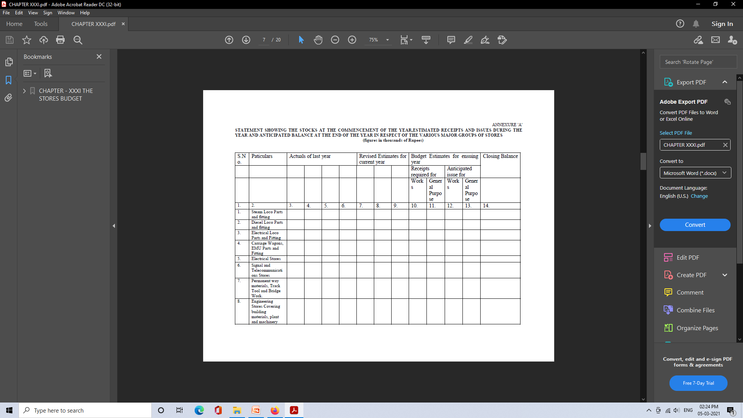
Annexure – A – Statement of Stocks

Slide 30
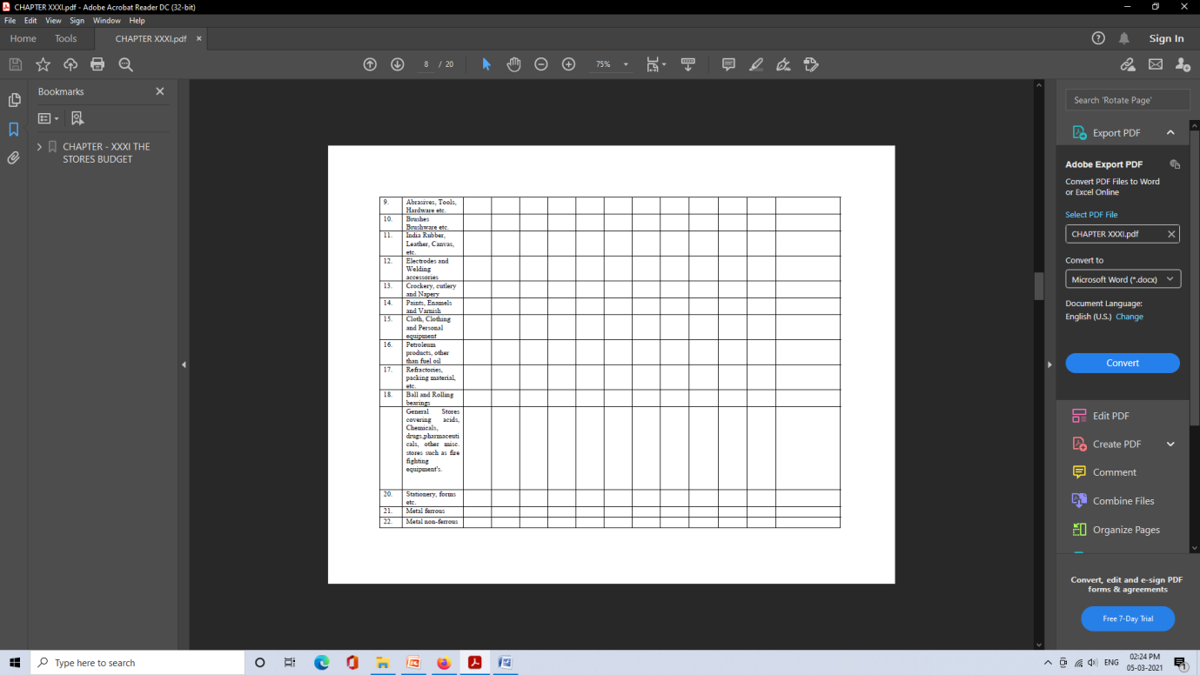
Annexure – A – Statement of Stocks

Slide 31

Annexure – A – Statement of Stocks

Slide 32
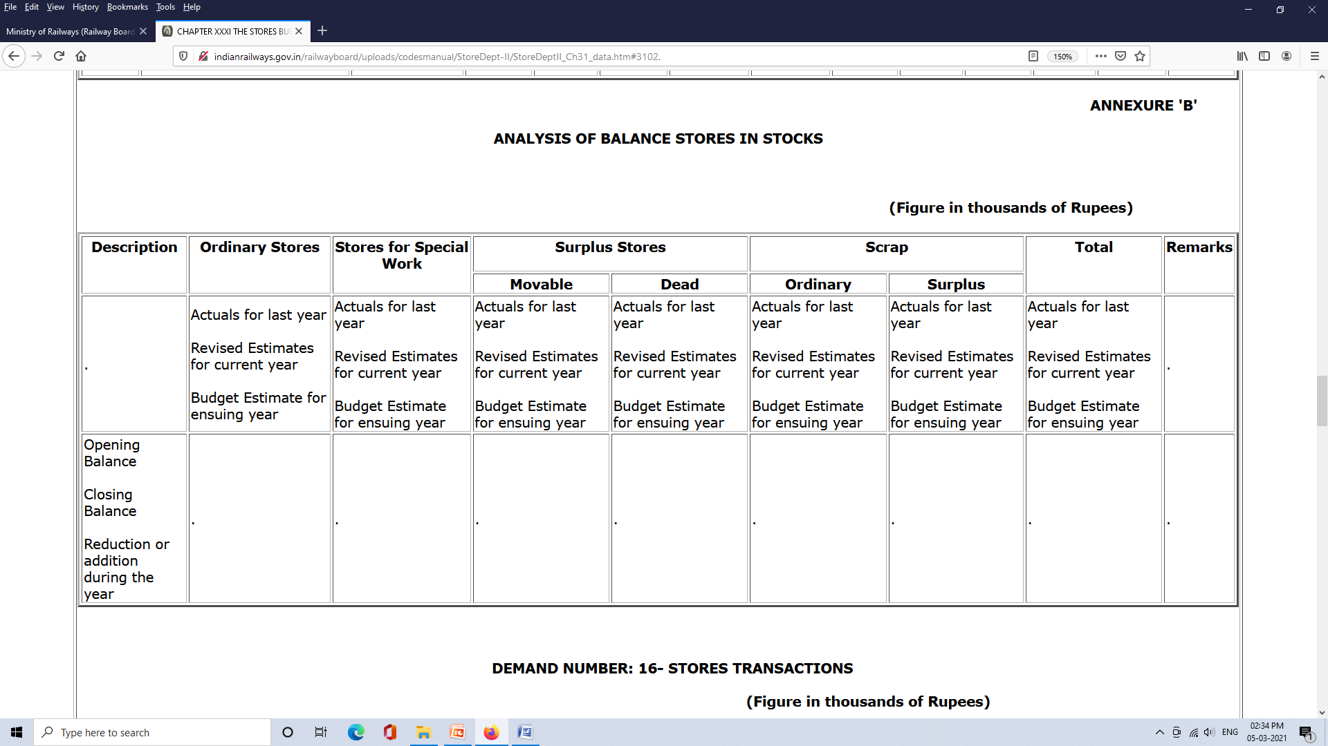
Annexure – B

Slide 33
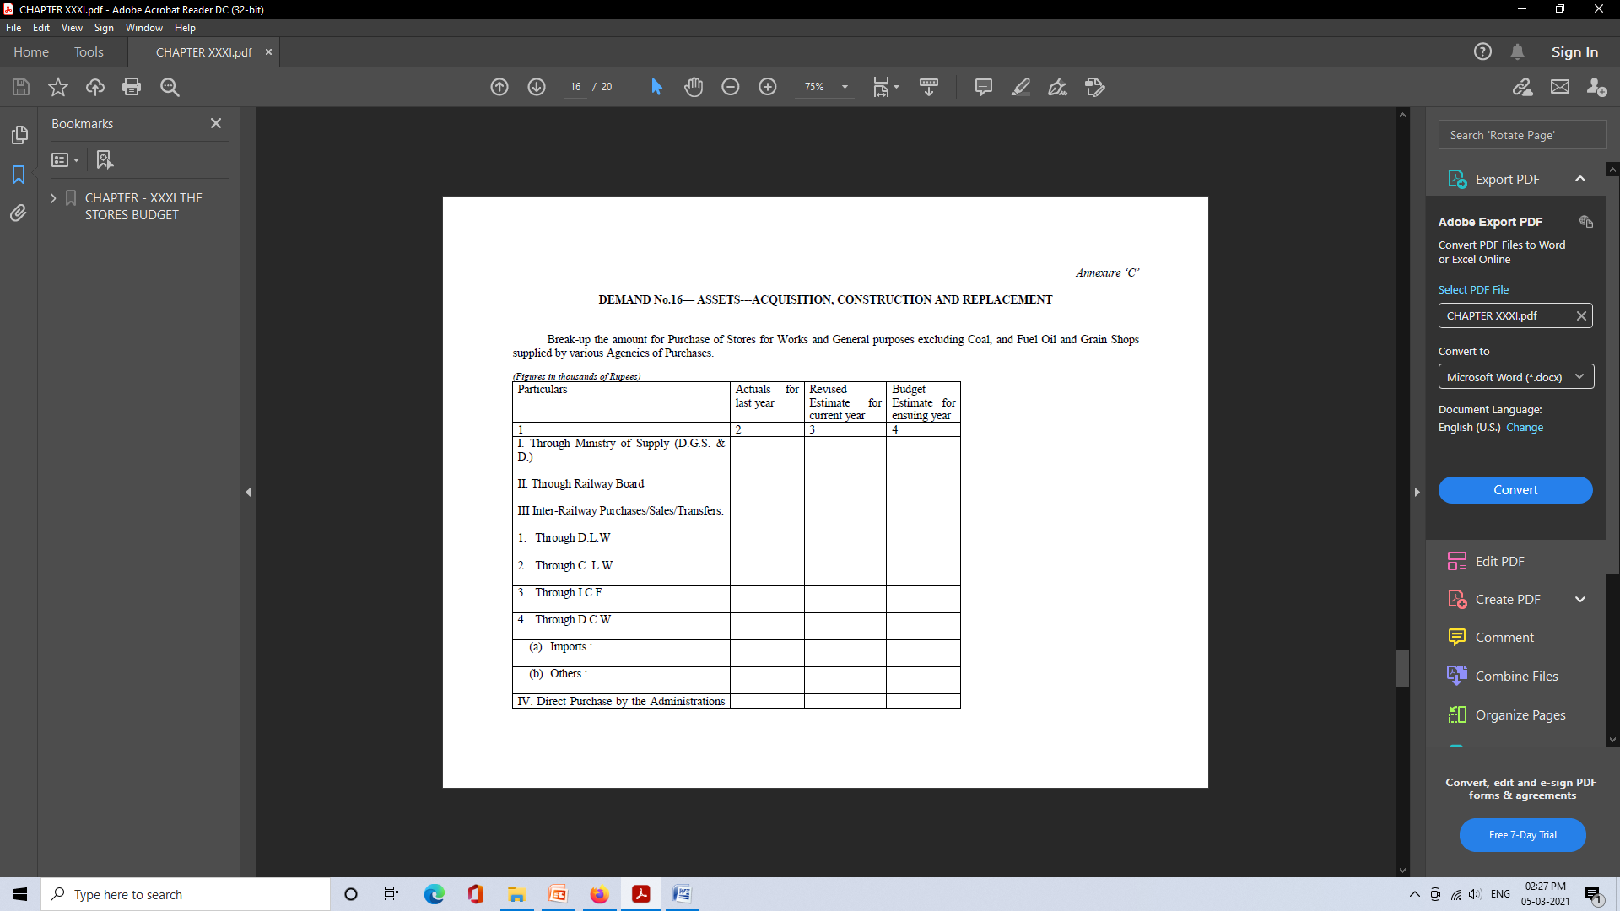
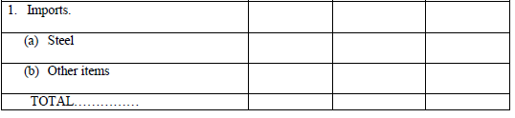
Annexure – C

Slide 34
Thank You

