Slide 1
CHAPTER XII, XIII & IV
STORES DEPOT
RECEIPT, CUSTODY OF STORES, ISSUE AND DEPOT LEDGERS
Presented By:
D.L.N Prabhakar
DY.CMM-IC-SCR-SC

Slide 2
Depot Officer
Who is Depot officer?
Each Stores Depot of any importance should be under the super­vision of a Gazetted Officer of the Stores Department, directly subordinate to the Controller of Stores (Principal Chief Materials Manager-PCMM). He is referred to in these rules as the "Depot Officer".

Slide 3
Duties of Depot Officer
Efficient Maintenance of Stocks.
Safe Custody of the Stores in Stock.
Correct tally of Stocks at any time with the Balances as shown in the Ledgers.
Correct preparation and posting of all initial documents, ledgers, bin cards and subsidiary registers.
Submission of the relevant vouchers and documents to the Accounts Officer on prescribed dates.
Disposals of surplus and scrap stores.

Slide 4
Wards and Sections
The work in a Stores Depot consists of :
(a) Receipt and Inspection of Stores.
(b) Storage and Issue of Materials.
(c) Desptach of Materials.
(d) Maintenance of “Numerical" Ledgers/Bin cards.
(e) Recoupment of stocks.
(f) Disposal of Surplus Stores and Scrap Materials.

Slide 5
Major Works in Receipt Section
Receipt of Material
Accountal of Material
Dealing of Rejections
Dealing of Warranty Rejections
Dealing of Advance Payment Cases

Slide 6
Receipt of Material
Source of Material: i. HQ Purchase Orders;
ii. Depot Purchase Orders.
Confirming Materials belong to that Depot: Consignee Details ,PO No, RPF Entry Details etc.
Unloading of Materials in concerned Wards after taking DRR and Maintenance of Dump Register.
Decanting of Oils from Oil Tanks: Checking Dip Measurement before Decanting in Storage Tanks.

Slide 7
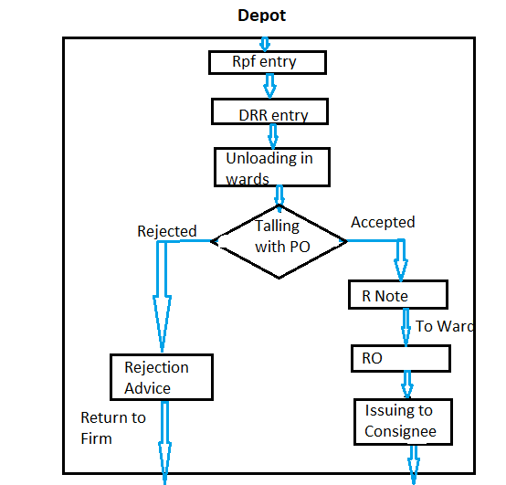
Flow chart of Material movement in the Depot

Slide 8
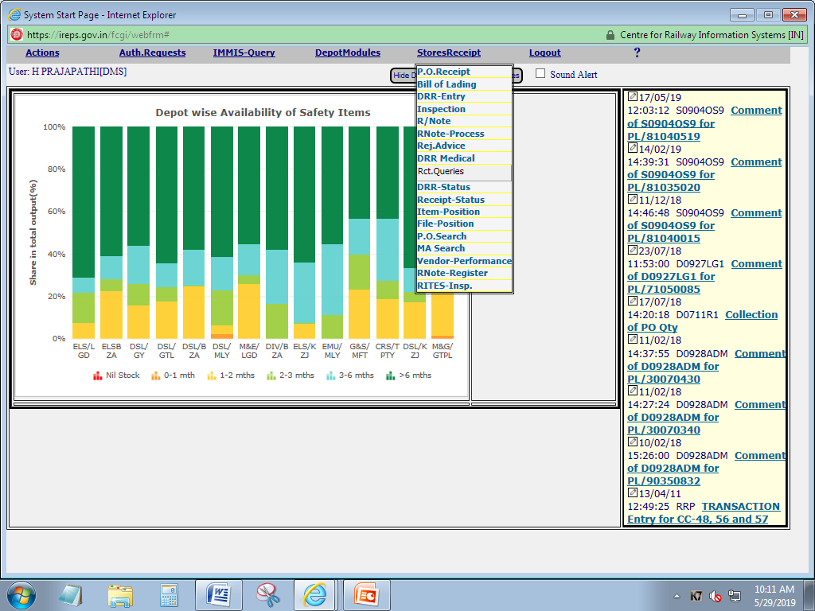
Receipt of Material
Stores Receipt:
All Receipt query and tasks like PO receipt, DRR entry, inspection, R- Note,
Rejection advice, DRR status, item position, PO search, MA search available in receipt module.

Slide 9
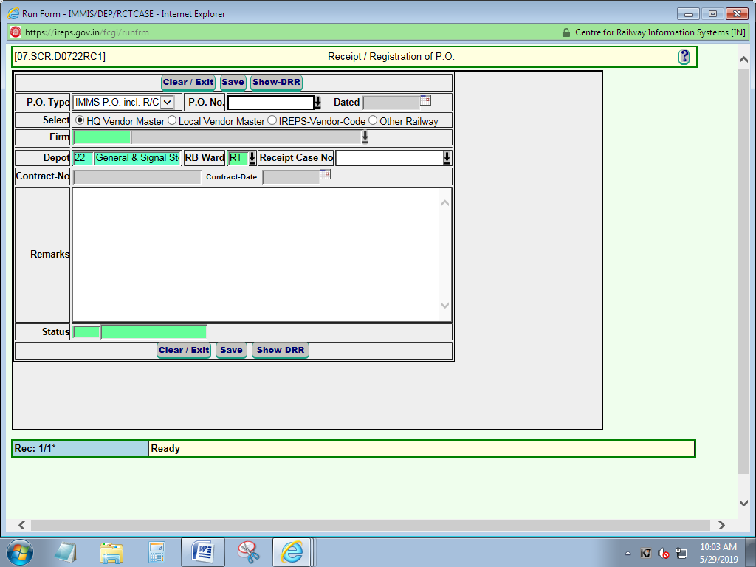
Receipt of Material
PO Registration:
Select PO type
Enter/dropdown PO no.
Enter receipt file No.
Save

Slide 10
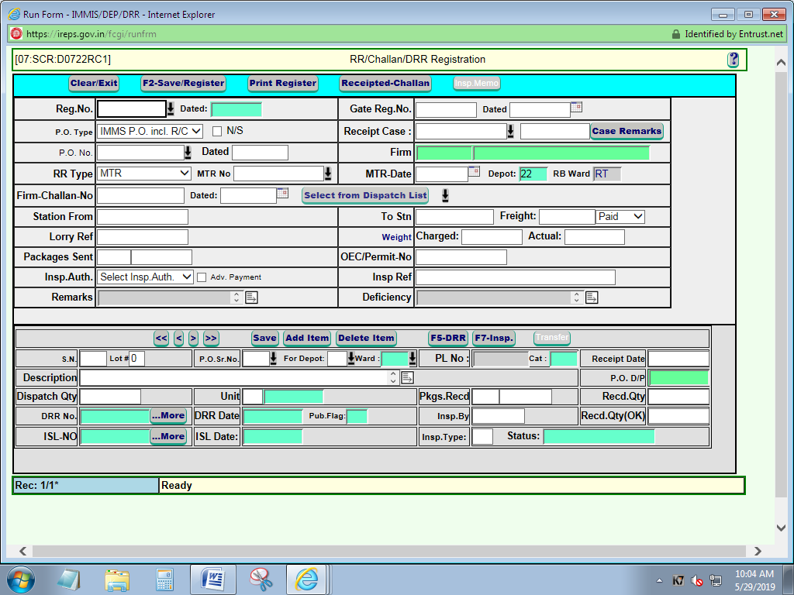
Receipt of Material
DRR ENTRY:
Enter PO no
Enter MTR/RR No and date
Enter Delivery Challan no/Tax Invoice no
Mention inspection particulars/Details
Enable/Disable Adv. Payment button based on PO condition
To save press F2-SAVE/REGISTER button
Select PO serial no
Mention Challan Quantity and packing details
Press F5/DRR button for DRR

Slide 11
Receipt of Material
After Un-loading of Materials:
        Certification of material Quantity
        Tallying material with description, Delivery period, Packing condition, Remaining PO condition.
        Quality : 1) Pre Inspection Details for Pre-inspected item
        2) Quality/ Dimensions/ specifications checking for consignee inspection Material.
        Acceptance.
        .

Slide 12
Receipt of Material
Issue of Receipted Challan:
Click Receipted Challan button
Authorize

Slide 13
Accountal of Materials
Generation of ISL No:
Press F7-Inspection Button to generate ISL no.
Note down ISL for future reference

Slide 14
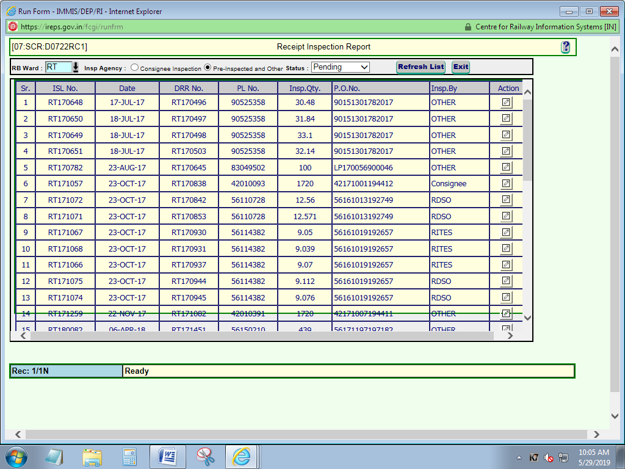
Accountal of Materials
Inspection:
Enter ISL No
Mention Accepted / Rejected quantity.
Save

Slide 15
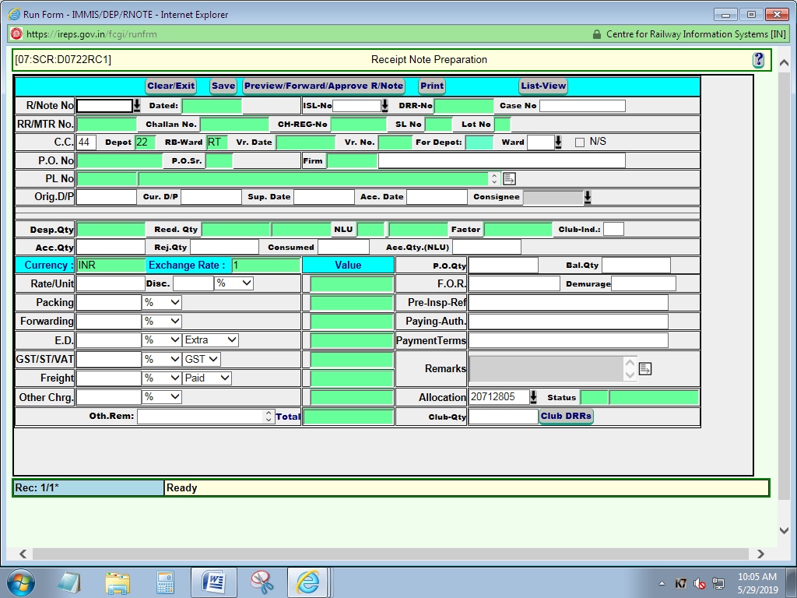
Accountal of Materials
R-Note preparation:
Enter ISL No
Enter date of receipt and acceptance of material
Enter balance Qty if balance qty available
Mention F.O.R details
Mention Paying Authority
Mention PO conditions, modification Details in remarks place.
Save
Publish R.Note

Slide 16
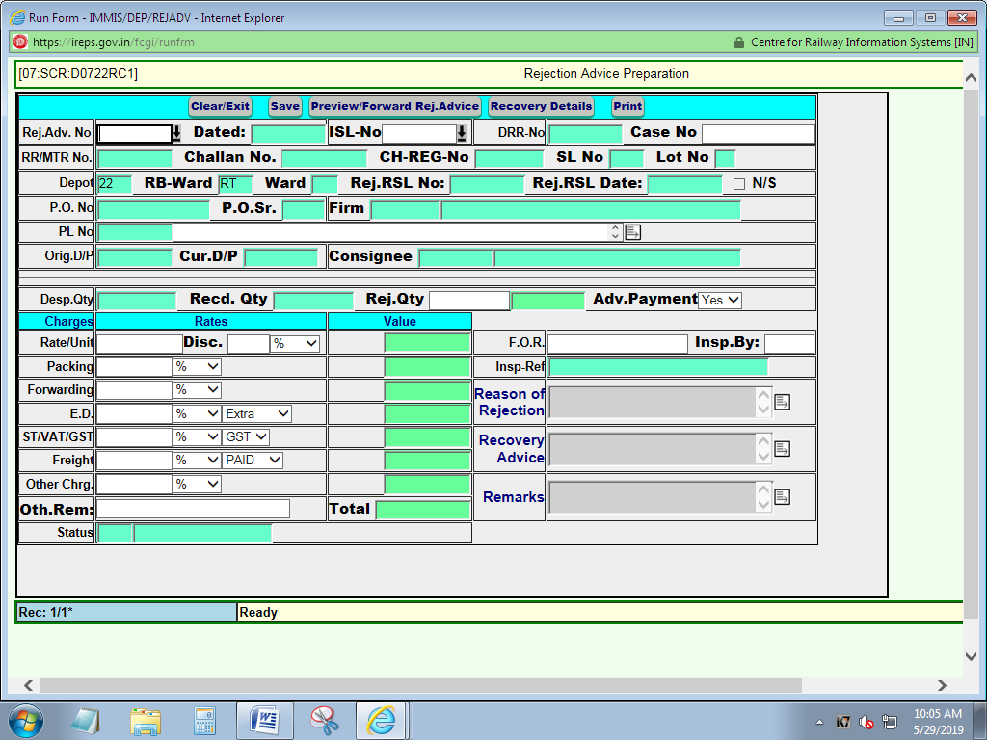
Rejection of Materials
Rejection Advice:
Enter ISL No.
Mention rejected quantity.
Mention recovery details if any.
Reason for rejection.
Save
Approve Rejection Advice.

Slide 17
Dealing of Rejection
Issuing of Rejection Advice
Inform firm for lifting of rejected material
Joint Inspection
Lifting of material by firm
No response from firm after stipulated time dispose the material

Slide 18
Dealing of Warranty Rejection
Collection of Materials from consignee for Claiming warranty
Accounting the material through DS.8
Preparing of Minus R.Note against Warranty claimed quantity
Informing firm for Replacement as per Inspection Clause
No response from firm Advice accounts for Recovery
If responded return materials to firm after replacement
If Firm asked material for rectification take the equal amount of BG or block the equal amount at account department from firm pending Bills
After successful completion of replacement withdraw recovery letter from accounts department if initiated recovery previously

Slide 19
Dealing of Advance Payment Materials
Collection of Proforma Invoice from Vendor, where ever applicable.
Preparation of Pay Order as per PVC.
Submission of pay order in account department.
Receipt of material and accountal of material
Recovery of difference amount from firm if any short supplies or any rate change situation

Slide 20
CUSTODY OF STORES & WORKING OF WARDS
ALL STORES DEPARTMENT(MATERIALS MANAGEMENT) ACTIVITIES ARE AND CONTROLLED AND CO-ORDINATED BY TWO VOLUMES OF STORES CODE (IN DIGLOT FORM – TWO VOLUMES IN BILINGUAL).
THE ABOVE CODAL PROVISIONS, UP TO DATE RAILWAY BOARD CIRCULARS, ZONAL LEVEL AND DIVISIONAL/DEPOT LEVEL CIRCULARS AND MSOP-2018 PLAYS A VITAL ROLE IN MATERIALS MANAGEMENT ACTIVITIES.
ESPECIALLY DEPOT AND WARD ACTIVITIES ARE CONTROLLED BY CHAPTER-XII & CHAPTER-XIII OF STORES CODE VOLUME-II WHICH COVERS RECEIPT AND ISSUE OF STORES, CUSTODY OF STORES AND ISSUE OF STORES.

Slide 21
Approximately there are about 2,00,000 Stock Items were found in Indian Railways and 43,000 Stock items in SCR at present worth Crores of Rupees.
Hence Railways have to Stock/Preserve/Warehouse these Crores of Rupees worth items in a scientific manner to cater the needs of their consumers(there are about 259 depots in IR)
Preservation of Stores under scientific procedures is very important phenomenon:
  To prevent from deterioration, damages, spoilage due to rust, dust, corrosion, weather, heat cold, and moisture and from fire etc.
  For economic utilization of available accommodation with proper facilities,
  For facilitating proper security to prevent from theft,
  For providing adequate storage yards, wards, godowns, bins, racks (both movable, immovable)
  By adopting latest ASRS system(Automated Stocking Retrieval System)

Slide 22
SLIGHT COMPARISION OF STORES WARD WITH A BANK
MATERIAL = MONEY
STORES DEPOTS = BANKS
STORES TRANSACTIONS = BANKS TRANSACTIONS
MATERIALS MANAGER = BANK MANAGER
WARD CDMS/DMS = CHIEF CASHIER/CASHIER
STORAGE BINS/SHELVES = LOCKERS IN A BANK

Slide 23
RECEIPT & ACCOUNTAL OF MATERIALS IN A WARD AND POSTING OF VOUCHERS WITH CARD CODEX
Through R/Notes(S-719) from Receipt Ward (Material Receiving Ward) that covers Trade items(indigenous and imports), Various items from different Production Units, Items from other Railways(issued vide Sale Issue Notes), Fabricated Receipts, New Heading Receipts etc.,.
Custodian of the Ward must ensure the Right Material, Right Quantity with OEM Packing/Challaned Packing with proper seals (if any) and at least 80% availability of Shelf Life as per PO(S-714)/R-Note description before taking into his/her custody and should publish the R/Order for this the Card Codex is 44.
The latest quantity received against above R/O should not mix with the already existed stocks and FIFO method should follow strictly during issues.
R/Note – It is a legal document for Receipt, Inspection and Acceptance of Materials (does not contain ward receipt continuity number).
R/Order - It is a legal document for Receipt, Inspection, Acceptance and Accountal of Materials (contains ward receipt continuity number).

Slide 24
Through Work Order/Workshop manufacture Receipts(S-1531) comprises of the work order stores, newly designed/developed stores received from the railway works shops/Plants. Ex: Lube oil filters etc...,.The Card Codex for the above receipts is 46 after taking accountal into a ward.
Through Depot Transfer Receipts(DTR)(S-1320) from Other Depots within the Railway Zone. The Card Codex for the above receipts is 47 after taking accountal into a ward.
Through Book Transfer Receipts(BTR)(S-1259) from Other wards of the same depot or same ward (due to changing of PL Number/UPL)(one Bin Card to another Bin Card). The Card Codex for this receipt is 43 after taking accountal into a ward.
Through Work Shop Returns/Return Stores/Depot Scrap (S-1539/DS-8/SR-15) received from work shops/sheds when they are not in use by the concern.
Ex: Dash Pot Oil etc.,. The Card Codex for the above receipt is 48 after taking accountal into a ward.

Slide 25
Through Adjustment Voucher after Reconciliation of Priced Ledger/Numerical Ledger(S-2547 & S-2548) (Excess or Shortages arises during Accountal/Departmental Stock Verification (Stock Adjustment Account-SAA). The Card Codex for this transaction is 60 after posting in Bin Card of the Ward.
After taking the material into his/her custody, the ward in-charge is responsible for safe custody of stores, maintenance of Bin/Tally Cards(Numerical Ledgers)with proper clerical postings(prevent arithmetical errors) both physically and electronically through IMMS, prompt/rationalized issues as per AAC, maintenance of ABC categorization, adopting FIFO methods especially for detoriorable items (Shelf life items), FILO methods for heavy/steel items as practically as possible.
Monitoring changing of BAR (book Avg Rates) after every receipt in to the ward.(BAR need not be same for an item in all depots within the zone).

Slide 26
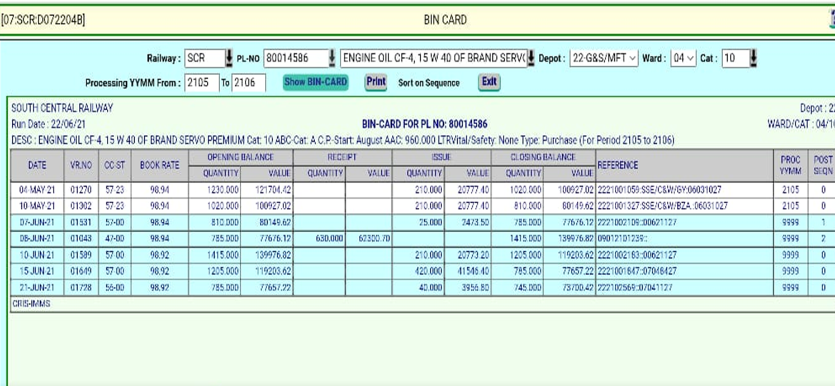
MODEL BIN CARD (IMMS VERSION)

Slide 27
TYPES OF ISSUES IN A WARD AND POSTING OF ISSUE VOUCHERS WITH CARD CODEX
Through Book Transfer Issues(BTI) (S-1259) issued to Other wards of the same depot or same ward (due to changing of PL Number/UPL)(one Bin Card to another Bin Card). The Card Codex for this issue is 43 after taking accountal into a ward.
Through Imprest Issues(S-1830) Scheduled Imprest Issues against Periodical Demands(PD) to multiple consignees. Ex: General Depots. (In this system the AAC’s of the different consignees are fixed by the Depot Class Ledgers/Ledger Section). Card Codex for this issue is 56 after posting the issue from the ward to consignee.
Through Ordinary/Regular Issues (S-1313) usually issued to single consignees by the depots attached to workshops, sheds etc.,. Card Codex for this issue is 57 after posting the issue from the ward to consignee.

Slide 28
Through Depot Transfer Issue(DTI)(S-1320) issued to other depots within the railway zone. The Card Code (CC) for this issue is 59 after posting from the ward to other railway unit.
Through Sale Issue Note (S-2337) Issued to other railways/ railway production units as per Sale order by the concerned depot officer against Purchase Order of the other railway unit.
The Card Code (CC) for this issue is 58 after posting from the ward to other railway unit.
In this system the Sales Suspense (purchase suspense) is arised by the associated finance(accounts department) it will be cleared after receipt of R.O from other Railway Unit.
The Ward custodian should monitor such cases and chase R.O’s immediately in order to avoid any such sales suspenses.

Slide 29
COMPLIANCE OF DEMANDS (Ward Procedure S-1308)
Compliance of demands(acceptance; if proper) is very important phenomenon in a Ward Procedure. Every ward custodian should closely watch the demands received for issuing of stocks. Presently, all the demands/indents from every consignee should be received invariably only through UDM (User Depot Module) of IREPS.
All issues should invariably rationalized as per AAC’s of the particular stores for regular issues or AAC’s of consignees in case of Imprest issues. And these issues should exactly match the indented PL Number.
Part Supplies/No supplies to be made only if insufficient stocks or no stocks are available duly following FIFO methods.

Slide 30
Ward in charge/Issue Clerk should closely monitor the issue of Safety/Vital/Ordinary and A-Cat, B-Cat, C-Cat and should always try to avoid the stocks below 3 months level(low stocks) or below 1 month level(Nil stocks) or Zero stocks., if any such cases happens, immediately co-ordinate with Ledger Section Staff for the Recoupment and Procurement processes thereby.
All receipt/issue postings should done only in Depot Module of IMMS, no manual entries to be made.
Write Back Issues/DTI’s/DTR’s, Minus RO’s should done by using depot officers Login ID’s & Pwd’s duly taking prior approval.
Efficiency of any Depot calibrated by its TOR (Turn over Ratio), which is depends on issue value of respective wards of that depot, hence ward activities are more prioritized.
More issue value minimizes the TOR and enhances the Depot efficiency.

Slide 31
MAIN DEPOT-SUBSIDIARY(SUB)DEPOT SYSTEM
STORES CODE VOLUME-II, CHAPTER-XIV
1) Recoupment of stocks (quantity to procure) by Sub-Depots from Main Depots (by Maximum-Minimum Methods).
SRM will move from Sub depot to Main depot for procurement process.
Net Procurement Quantity will be finalized by Main Depot Officer for all sub depots and procurement process will starts.
2) Recoupment by Main Depot for all sub depots for any particular item duly obtaining Quarterly statements from each individual sub depots.
3) After receipt of material duly posting the R/O the Main Depot has to distribute the materials to respective sub depots vide DTF’s on top priority in order to avoid over stockings.
4) Ex:- Centralised Purchase Ward (CPW) at DSD/KZJ will receive materials from various PU’s and distribute the same to other Diesel Stores Depots.

Slide 32
CONCEPT OF SHELF LIFE
(for early deteriorable items)
* Shelf Life is a period, which covers the life of an article between its date of Manufacture and that of its being put into áctual service.
Ex:- Paints, Batteries, Torch Cells, Rubber items, Chemical items, Explosives etc.,.
Shelf life at least should available up to 80% on the date of receipt of the material from the date of manufacturing.
No further extension of shelf life should be allotted for any kind of items.
Shelf life items should strictly be issued on FIFO (First In First Out) method and should use by the end user immediately on receipt.
Usage of these items after shelf life may affects the entire system, hence such practices may avoid.

Slide 33
STORAGE IN BINS/RACKS/PALLETS MATERIAL HANDLING EQUIPMENTS
Every stores depot must possess the Bins, Pallets, Racking Systems, and also Material Handling Equipments in addition to warehousing constructions for economic storage of railway materials.
Bins and Pallets are crates of proper dimensions with short legs made with wooden/metallic and can be stacked one above another without fear of topping. It reduces the space required for storage as well as neat looking.
Racking System made with iron/steel comprises of moveable racks, non-moveable racks, vertical racks, racks with trays and in recent days ASRS racking systems for storage of railway materials with more efficiently in less occupied space.

Slide 34
Material Handling Equipments comprises of Platform trucks, Lister Trucks, Fork Lifts/Flow Cars, Cranes, Battery Operated Stackers, Hand Operated Trolleys, Hydraulic Trolleys etc., for easy/economical and efficient handling of materials.
In addition to the above, Dunnages of wooden/timber made, iron sleepers, concrete sleepers, unused rails were also used to kept the materials on above(like platforms) so that to prevent from direct attachment to the soil.

Slide 35
PRESERVATION OF SOME IMPORTANT ITEMS OF STORES
RUBBER GOODS: Should always keep under Dry, Dark and Cool places(temp.below 27 degrees)
Exposure of rubber goods to sunlight and air leads to oxidation and forms brittleness and the quality reduces thereby.
The rubber stocks should periodically sprayed/dusted with French Chalk Powder or Soap Stone Powder.
TIMBER/WOODEN ITEMS: Wooden items can be stocked in two forms: aquatic storage(for huge logs in olden days) and terrestrial storage(for cutting wooden things).
Cut timber should be store in good air ventilated sheds with open top cover of asbestos to prevent from insect borers, termites, microorganisms(fungi & lichens).
Borax powder, penta-chlorophenol can be sprayed.

Slide 36
ACIDS: Should be store under ventilated, cool places on concrete floor with a layer of 5cm sand,
Avoid sunlight and using shelves for storage,
Usage of rubber gloves and gum boots while handling acids is must,
A neutralizing solution of 10% bicarbonate of soda should be kept ready to prevent from accidents.
This solution should also sprayed on the four walls gently to prevent from corrosion of walls periodically.
The containers(porcelain jars) should be covered with molten paraffin wax.
BATTERIES: Should be stored in separate godowns under air ventilated(free circulation of air), humid free atmosphere.
The terminals should be waxed (with petroleum jelly) for charged batteries like Lead Acid Batteries,
Torch cells should be stacked under OEM packing condition under cool places.
The shelf life of batteries enhanced by taking above precautions.

Slide 37
Calcium Carbide: Should always be kept away from moisture and water and should be kept under uninhabited/isolated godowns with completely dry, well ventilated rooms.
Produces inflammable gas Acetylene if contacts with moisture or water.
Hence, the stocked quantity should always be less than 28 lbs(pounds) ( or approximately 12 Kgs) only (for private parties it is 5 Kgs only). To stock more than this, requires a license from Ministry of Industry(GOI circular dt.18-02-87)
ELECTRODES: Should kept in OEM packing(usually metal containers) under dry, humid free atmosphere.
During rainy seasons should kept under heat providing arrangements(like big ovens) to prevent the formation flux coating on their surfaces.

Slide 38
Paints,Enamels,Varnishes: “A paint is a mixture of pigment-binder-thinner”. Sedimentation and thickening are common phenomenon in paints, hence periodical rolling is must to prevent this.
Periodical Rolling Register should invariably maintain in a paint stocking wards duly signed by the Ward custodian, Assistant Depot who rolled down and CDMS/Genl.
Paints should always stores in cool godowns to minimize the loss of volatile solvents (thinners).
Explosives(Fog Signals): Should be stores in fire-proof , closed, secured godowns.
Generally supplied in metallic tin containers covered and packed by wooden boxes.
According to Indian Explosive Rules-1914, Division-I, Clause-B, Railways not require any license to purchasing, stocking and distributing.

Slide 39
Clothes, Garments, Textiles: Should be stocked in Steel Almirahs(closed or open) reasonably free from moisture.
Should be wrapped with paper in these garments duly using napthalene balls.
High temperatures degrades the colour of the cloth, hence avoided.
Lubricants, Grease: Lubricants like engine oils, cutting oils, hydraulic oils, gear oils, linseed oils etc., the barrels should be kept in 3 ‘O’ Clock – 9 ‘O’ Clock Position (horizontally) for ease to loading/unloading practices and to identify leakages, in any.
Grease Barrels should always be in 6 ‘O’ Clock – 12 ‘O’ Clock Position (vertically).
Periodical inspections should be carried out to spot leaks or rusting of the barrels.

Slide 40
Issue and Distribution of Stores
Stores Depot receives, inspects and stores various materials for the basic
purpose of issuing them to various consumers of the Railways.
Consumers may be various subordinates/officers of the divisions or other
units such as workshop etc.
They may require the materials either for maintenance and operation or for new works
Therefore, the depot has to ensure a good system of issue of the materials to cater to all types of
issues to all types of indenters

Slide 41
The system has to ensure following basic
things in issuing
Materials should be issued on proper authority i.e. there should
be a proper requisition from the Indentor.
(b) There should be a proper system of keeping records of all requisitions submitted by the indentors so that various queries of the indentors about compliance of their requisitions may be adequately dealt with.
This system should also be capable of providing managerial information required to monitor the productivity of the system and also to improve the same.

Slide 42
(c) There should be a system of detecting a demand which is placed by the indentor for the quantity which is more than the quantity sanctioned for him by the competent authority. (In Railways this system exists for imprest stores, few Consumables and stationary
items.)
(d) Issues should be made without any delay.
(e) There should be a proper system of keeping accountal of the issues and raising timely debits to the units to whom the materials have been issued. For this all concerned officers/officials should be informed in time about the issue of the material.
f) Materials once issued, should not form a part of the physical inventory of the stocking ward.
(g)There should be minimum possible wastage due to retail issues etc.
(h)Materials issued should be correctly measured.

Slide 43
Different types of forms have been designed to deal with different types of requests for issue of materials.
These forms are -
i)Requisition for stores (S-1313) or S.1302
ii. Combined requisition & Issue Note (S 1313 / S-1319).
iii. Imprest recoupment schedule (S 18 30)
iv. Issue tickets (for workshop items).
v. Depot transfer orders, Depot transfer requests.
All these requisitions are received in a centralized section in the Depot.
All the requisitions on receipt, are entered in a Requisition Register

Slide 44
Scrutiny of Requisitions
After entering details in the Requisition Register, requisitions are scrutinized to see that the requisitions have been properly prepared and allocation i.e. Head of Account to which expenditure is to be charged is correctly given.
There should also be no ambiguity in PL No. and description of the material demanded.
For imprest items or consumable stores for which indentors are sanctioned specific quantities (for a specific period) by their controlling officers, separate registers are required to be maintained to ensure that materials in excess to sanctioned quantity are not issued, otherwise it
may result in short supply of the material to other indentors.
As per para 1307-S all requisitions should be forwarded to stocking
wards within 24 hours of their receipt in the Depot office.

Slide 45
Issue of Material and Granting of Issue Note Nos
All the requisitions, imprest recoupment schedules, Depot transfer etc. are finally received in the stocking ward for the purpose of issue of the material.
The DSK Stocking Ward will take the quantity out from the stocking bin and will either deliver to dispatch section or keep it separate in a corner.
If the materials are not immediately handed over to dispatch section, they should be kept separately but safely.
As far as possible original packing should not be removed.
At the same time ward will prepare the Issue Notes and when the materials have either been handed
over to dispatch section or are kept separate for handing over to dispatch
section details will be entered in the Issue Register.
After this, Issue Note will be numbered.

Slide 46
Issues To Workshops :
For issuing materials to the attached Workshops slightly different procedure is followed :
Materials to the Workshops may be issued either directly from the Ward or the Depot may have a Sub-Ward which will temporarily stock the materials regularly required by the Workshops and will deliver them to the respective Shop Superintendent on `Issue Ticket' (Paras S1504 to S 1522).

Slide 47
DEPOT LEDGERS
What is a Ledger?
  Ledger is book or other collection of financial accounts.
  A book of stores transactions, recoupment and inventory control.

Slide 48
  Objectivies of Ledger Section
  To ensure the prompt recoupment of stores at the depot.
  To cover the shortfalls
  Responding the latest consumption trend of material by the end user.
  To control inactive and surplus items.

Slide 49
Functions of Ledger section
Critical Scrutiny and processing of SAF and opening of new headings.
Prompt submission of updated AIS to the HQ
To alert the HQ in case of short fall
Registration of coverages against pending demands and follow up HQ for un-cover dues.

Slide 50
Functions of Ledger Section..Contd 1
Placing emergency recoupment through Local Purchase
Monitoring over stock, inactive and surplus stores.
Periodical review of ‘A’ cat. Items to avoid blockage of inventory.
Co-ordination with custodian and user department to achieve inventory targets.

Slide 51
Recoupment Methods
Annual Estimate
Maxima and Minima
Base Stock Method of recoupment
EOQ method of recoupment
Long term contract,
Procurement and Consumption Efficiency

Slide 52


