Slide 1
FOIS, PMS & TAMS
K. Venkateshwarlu
ADFM/ HYB
9701372103
1

Slide 2
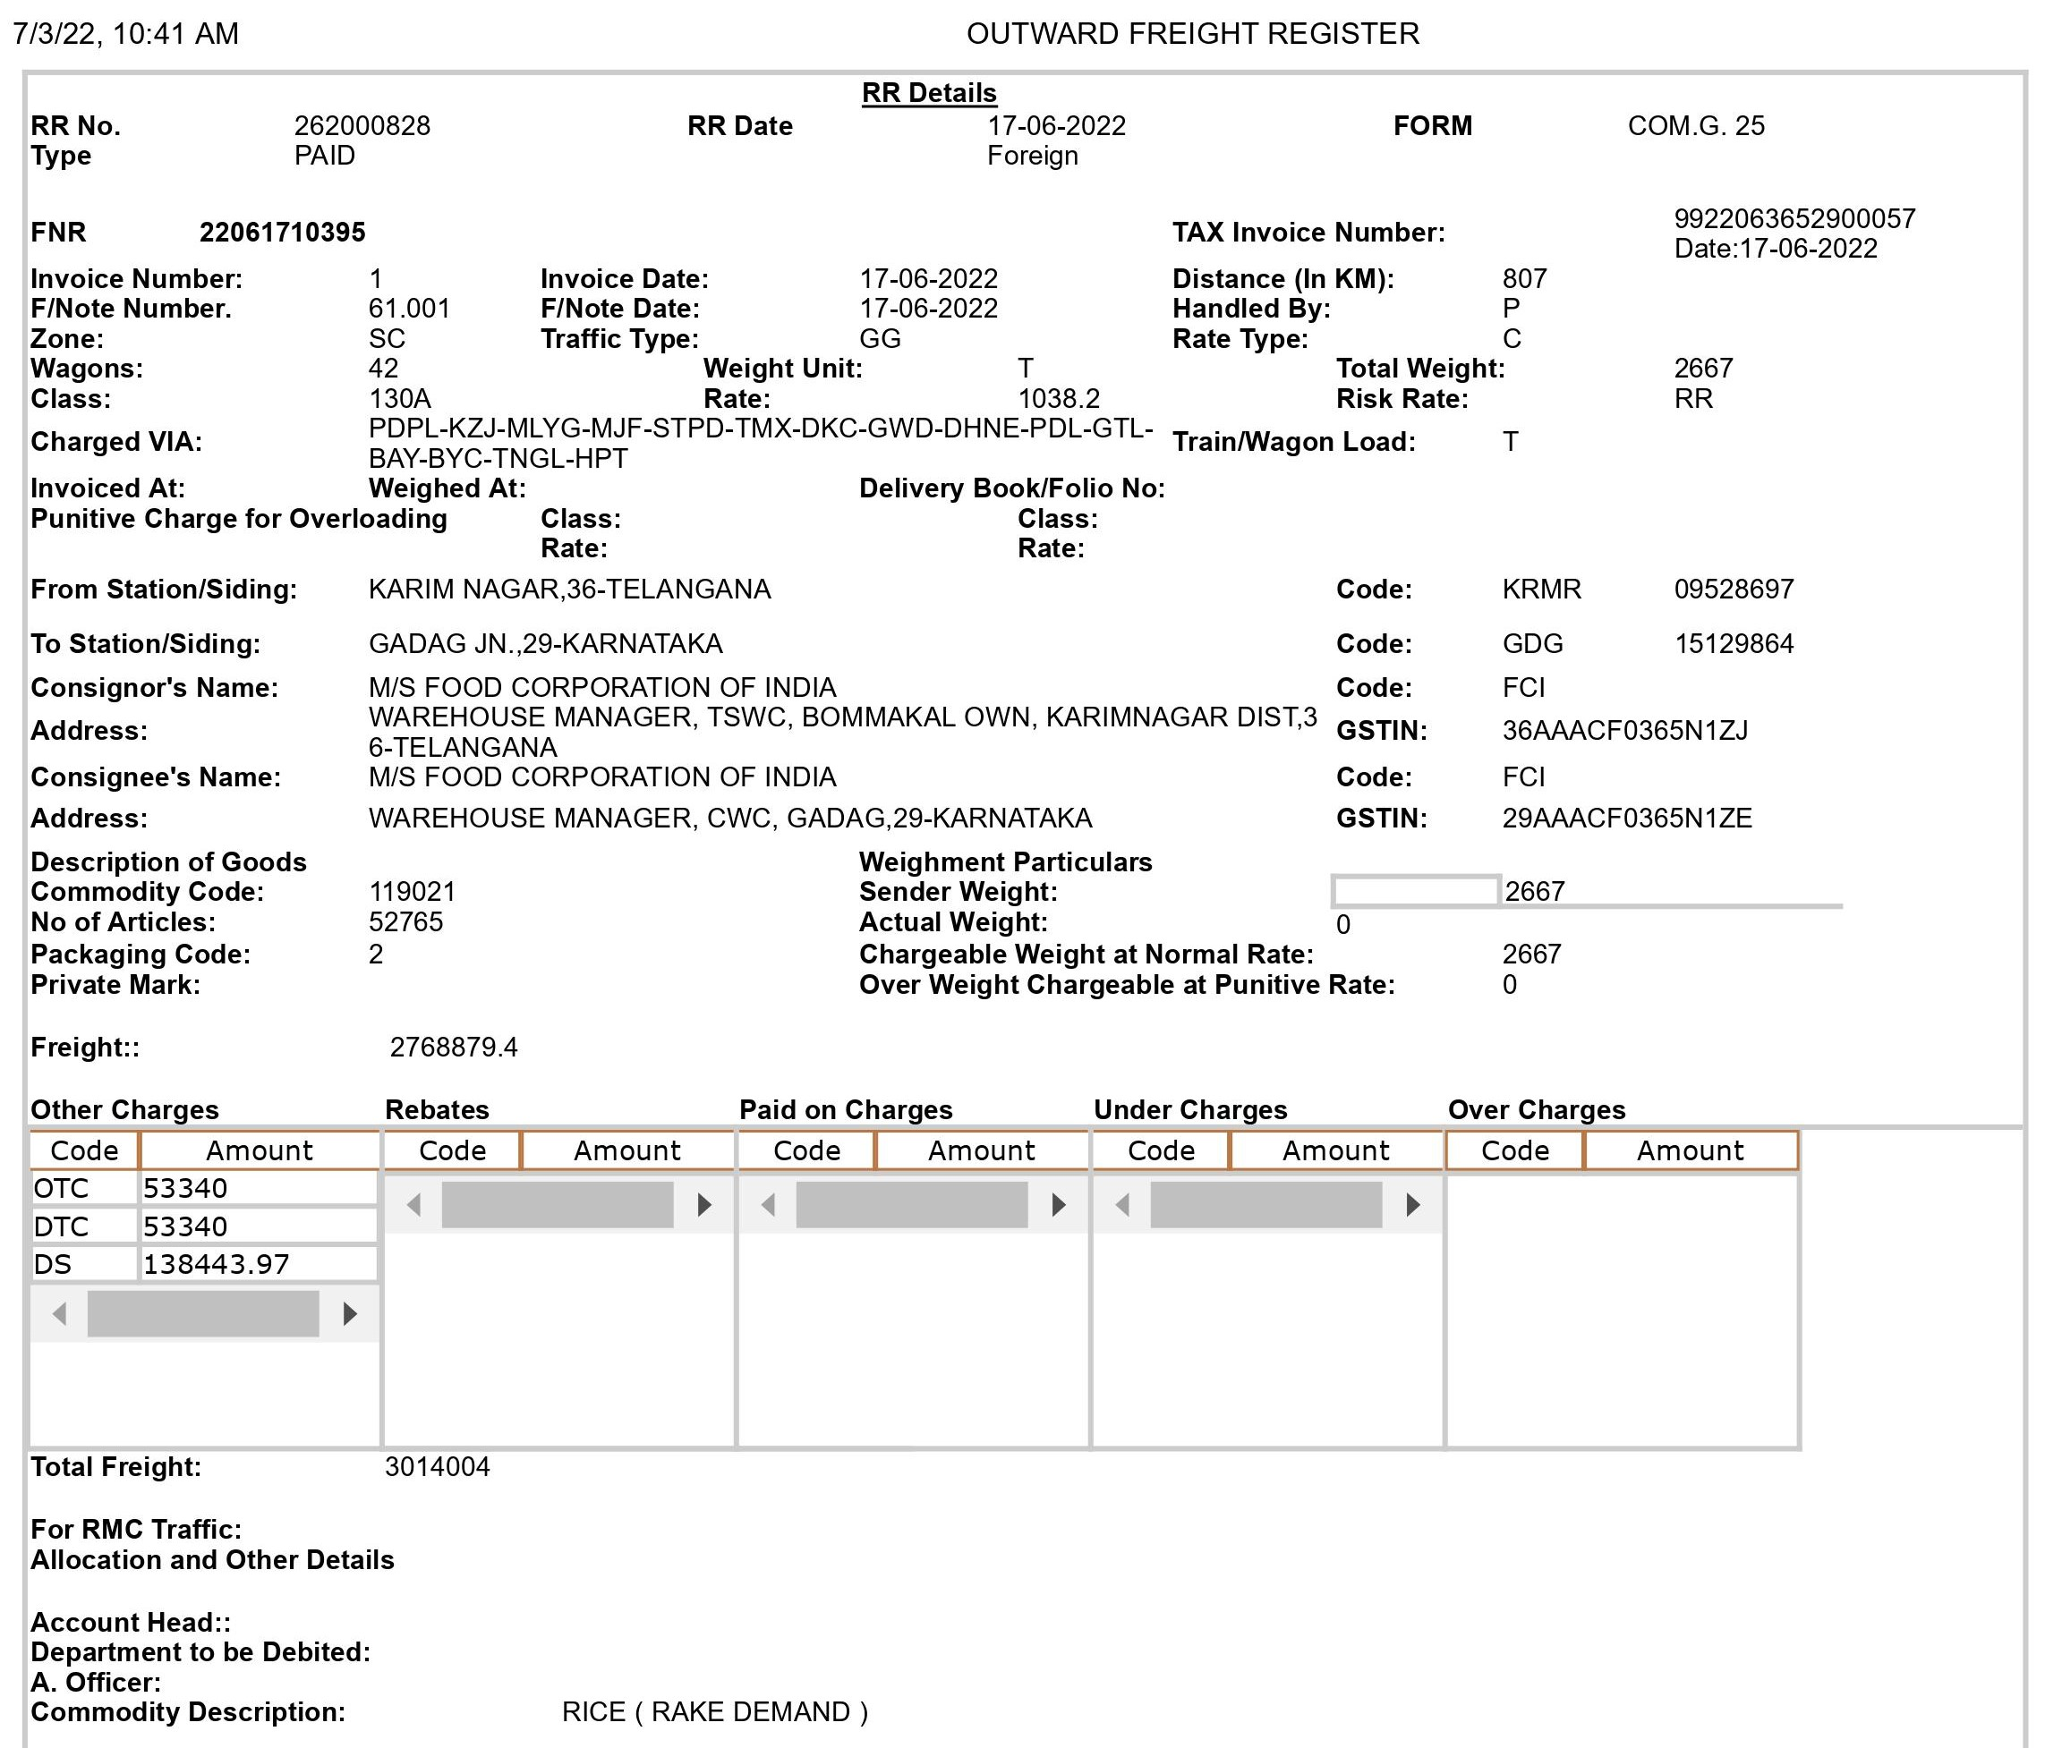

Slide 3
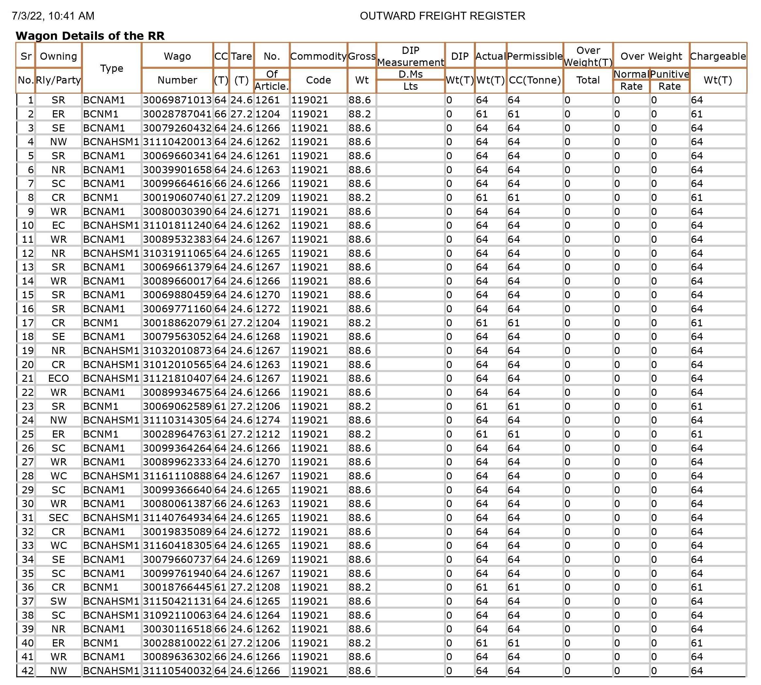

Slide 4
Freight Calculation | Rate/ T | Weight | Amount
Base Freight | 1038.2 | 2667 | 2768879.40
(+)BSS Busy Season Surcharge(15%) BFR | 0 |  | 0
(+) BAN/PAK Surcharge(25%/20%) BFR | 0 |  | 0
(+) PORT Surcharge(10%) BFR | 0 |  | 0
= NTR (Net Tariff Rate) |  |  | 2768879.40
(+)DS (Development Surcharge) 5% on NTR |  |  | 138443.97
(+)OTC (Originating Terminal Charge) | 20.00 | 2667 | 53340.00
(+)DTC (Destination Terminal Charge) | 20.00 | 1667
Sub-Total |  |  | 3014003.37
(-) Graded Concession (25%) on NTR |  |  | 0
Sub- Total |  |  | 3014003.37
(+)GST (5%) |  |  | 0
Total |  |  | 3014003.37
Rounded off |  |  | 3014004.00

Slide 5
How the Freight Calculation is done in FOIS
TYPE | INPUT
Wagon Type | Manual
Gross weight | Semi
Tare weight | System
Actual weight | System
PCC/ Chargeable Weight | System
Route/ Distance | System/RBS
Class | System
BFR/Rate | System
Surcharges | System
Concession | System
Location specific | Manual
Adjustment (FAOC/FAUC) | Manual

Slide 6
FOIS RR(FEATURES)
SAME STATIONERY FOR ALL TYPE OF RRs
261004438
  1st Digit Type of Traffic
    1-Govt Coal 2-General Goods 3-Military Traffic
    4- Public Coal 5-RMC
  2nd Digit (Type of Payment)
  1.Paid 2.To-pay 3.Paid-To-pay 4.E-RR (Technical Failures) 5. E-RR (Insufficient funds) 6. Paid E-RR (Normal)
  7.Paid RR (Advance Freight)
  3rd Digit (Type of Destination)
  1.Local 2.Foreign 3.Inter Dominion
  4-9 Digits Serial Number of RR
Notes:
6

Slide 7
FOIS
RMS
Rake Management System
TMS
Terminal Management System

Slide 8
FUNCTIONS OF RMS
Rake Formation (With a Rake ID)
Confirm Consist
Rake Movement/ Movement Order
Inward Number Taking
Operating Placement
Wagon attachment/ detachment
Generation of various reports
BPC details reporting

Slide 9
FUNCTIONS OF RMS
•Crew Reporting
•Attach a Loco
•Ordering of Train
•Departure
•Reporting of Train at Compulsory
reporting stations
•Terminating Loads at Destination
•Interchange Forecast Reporting

Slide 10
FUNCTIONS OF RMS
INTERCHANGE
Divisional and Zonal
•Indicates days performance of a Division or Zone
•Improve performance by handing more trains

Slide 11
FUNCTIONS OF TMS
Indent Registration with WDRF collection details
Forwarding Note preparation
Commercial placement of a Rake
Release of the Rake as loaded or empty as the case may be
Loading-Unloading-Removal
Rebooking of a rake, if applicable

Slide 12
FUNCTIONS OF TMS
Filling up of Loading/Unloading register
Feeding consignment removal details
Checking for automatic accrual of Demurrage and Wharfage charges
RR generation with automatic accrual of freight charges
Issue of Railway Receipt for various types of traffic including for Container Traffic with various concessions/ surcharges.

Slide 13
FUNCTIONS OF TMS
Provision for feeding of payment details of Freight or e-payment
Provision for feeding waival details of DC and WC
Provision for feeding of balance DC and WC collections
Reporting for Remission of station earnings into bank/cash office

Slide 14
FUNCTIONS OF TMS
Provision for feeding of various charges pertaining to goods working at a station/siding
Automatic preparation of Goods balance sheet in the system
Provision for various queries
Provision for getting various reports(save/print)
TMS Queries

Slide 15
FOIS-Balance Sheet
Main Menu
Queries
Charges
Balance Sheet

Slide 16
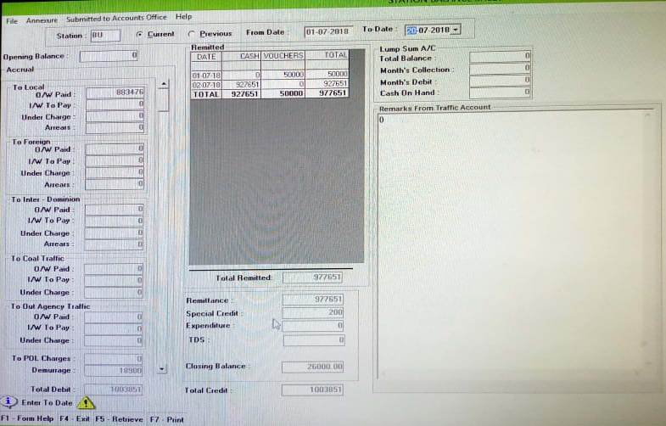
FOIS-Balance Sheet
OB | 101475 | CRN | 977651
OW PAID L | 883476 | SPL CR | 200
DEMURRAGE | 18900 | OUTSTANDING | 26000
TOTAL | 1003851 | TOTAL | 1003851

Slide 17
PMS Features
Direct capture of parcel weight Electronically
Tracking parcel with help of barcode technology
Any route booking through single window at any counter. No need to go to another booking window after filling forwarding note, hence single window can be followed for weighing, cash payment and issue of Parcel Way bill
Advance loading guidance according to availability of space
Prior information about the inward traffic

Slide 18
MODULES
Forwarding Note
  With the help of Electronic weighing machine weight of parcel is directly captured and sent to the system in this module. After complete information of consignment is filled, a unique forwarding note number is generated

Slide 19
Modules
Booking of parcel, Luggage and VP
Forwarding Note number generated in above module is fed into the booking module, thereby details of consignment to be booked by party comes into the screen and freight is calculated automatically. A unique 10-digit no. called PRR (Progressive Reference Record) No. is generated.

Slide 20
MODULES
Barcode generation
  For above unique PRR no. a Barcode Label is generated and pasted on the items to be sent for one to one tracking of consignment.
  Barcode Label contains information about the consignment in coded form.

Slide 21

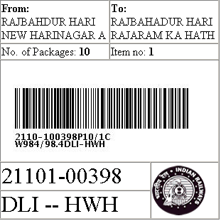
Above Barcode When read by scanner reads as below
\09921101003980001HWH^
099 → Wt of package.
2110100398 → PRR No
0001 → Item No
HWH → Destination Stn

Slide 22
Barcode Scanner
Barcode scanner is a portable Sophisticated Hand Held Device used to read Barcode Labels pasted on every package during Loading & Unloading of Packages from train so that every package can be tracked accurately out of a lot.
Data is then transferred & updated to system from Barcode Scanner.
Standard CODE128 is used for printing of Barcodes. Code 128 provides good density between lines in barcode for all-numeric data and alphanumeric data, thus improves readability over other standard codes.

Slide 23
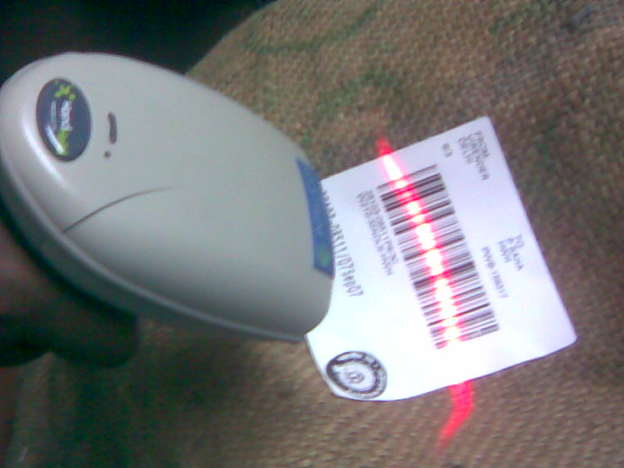

Slide 24
MODULES
Loading
On selection of a Train no., loading potential displays all the parcels available for dispatch for a particular destination in a particular train scale.
  Based on the selection of packages Loading guidance is generated. Packages sent along with loading guidance to platform for loading.
  Parcels can be loaded after scanning by Barcode scanner and loading summary is recorded.

Slide 25
MODULES
Unloading
Destination station has advance unloading guidance
  Inward packages can be scanned on arrival at platform to generate unloading summary.
Inward godown
Unloading summary generated on connectivity of
Barcode scanner with terminal
  Inward packages can be scanned on entry in Inward godown

Slide 26
MODULES
  Delivery
Recipient comes to delivery clerk with original receipt. PRR no. on the receipt is then feed by delivery clerk in delivery module. All the delivery details with charges comes on the screen. The delivery receipt is then generated by the delivery clerk.
Goods are given to customer against the delivery receipt.
  Tracking of parcels through online information of parcels on internet
Customer can track its parcel against PRR no. on the parcel receipt.

Slide 27
MODULES
  MIS Reports
Report for parcel booking clerk, destination wise summary, counter wise summary, left-over packages, summary and various other reports can be generated by system
  System Administration and Master Maintenance
This module helps in creating user database, adjusting the stationary number, logging out the locked user etc.
Station, Train master are updated by Database administrator at CRIS/New Delhi.
Party Master, Lease Party and Contract Master, FSLA Party master etc. are maintained by Parcel Office Supervisor.

Slide 28
MODULES
Lease
This module covers the Leasing of Parcel Space in the passengers Trains to the private party.
FSLA (Freight Service & Ledger Account )
This module is for daily Registered Newspapers & magazines to be dispatched in train by paying some security in advance and pays the dues at the end of the month.

Slide 29
MODULES
  Training
Audio visual help file installed at each terminal. This helps new user to listen and see how to use the modules in software.
  Bug reporting
For reporting defects in software user can log it in this module, which can be viewed by software engineer at CRIS and can send the corresponding reply in that module itself

Slide 30
Benefits
Web-enabled to track latest position of the parcel
Automatic freight calculation based on latest rules
Reduction in human errors & manual intervention
Reduction in time required for weighment and booking
Loading strictly according to priority thereby curtailing malpractices and complaints
Beneficial to Accounts for internal check
Reduction in Claims
Potential for revenue generation based on improvement in service.

Slide 31
Why TAMS
FOIS caters RR generation and operational features.
UTS/PRS caters generation of Tickets.
There is no single software to collect and compile the Revenue transactions.
FOIS, UTS, PRS do not give the consolidated status of revenue transactions on monthly basis.

Slide 32
Objective of TAMS
  Integration of all Accounting Returns for different verticals of earnings of IR: Passenger, Goods, Other Coaching and Sundries
  Collected Earnings to reconcile with cash book
  Originating Earnings : Transaction number + transaction value for statistical statements
  Apportioned Earnings: 7C for Goods and 6A for Passenger
  Integration of Computerized Balance Sheets in TA office
  Generation of Traffic Book : Part A,B,C and D
  Linking of Balance-sheet with cash office module of IPAS
  Generation of Earnings Account

Slide 33
Conceptual Endeavour of TAMS
Reduce manual intervention on basic data to minimal
Internal check – completely online with smart checks and validations
Tweaking more on FOIS, UTS and PRS - ease of applicability and integration
Reduction of overall aberrations / modifications in the revenue data – all correction through error sheet module.
Reconciliation to be made part of the accountal and data flow
MIS to support future decision making
Almost all transactions to be part of station B/s
TIA inspections – smarter and online
Traffic finance and costing to be on IT platform
Final JV and account current to be seamless.

Slide 34
TAMS Development & implementation
No re-invention of Wheel- TAMS utilises the features available in FOIS, PRS/UTS/PMS, with necessary tweaking, minor modifications to suit the requirement.
All modifications in the data shall be routed through Error sheet module only for accountal and traceability.
All the entries will appear in Balance Sheet only after due reconciliation in the system, thereby internal check is ensured.
Balance Sheet will be the final outcome of the station transactions duly considering the all activities without any manual adjustments in the Balance Sheet.

Slide 35
Components of TAMS
Apportionment of Passenger & Freight Revenue.
Statistical Statement of Passenger Traffic – 6A
Traffic Book -Part A, B, C & D
Accounts Office Balance Sheet (AOB)
TIA module.
Station Balance Sheet (Cog & Goods)
Error Sheet module.

Slide 36
Traffic Book part ‘B’
Present Procedure.
Apportionment Matrix from CRIS.
Manual Exchange of Net results.
Manual feeding of JVs in IPAS.
Requirements in TAMS Module.
Creation of new file for net result
Exporting the data to IPAS
System Based generation of Railway wise Outward and Inward JVs for incorporation in Account Current.

Slide 37
Error Sheet Module
B/S Internal Check
CR Note not received
D&W
Siding & Shunting
RRs check & others
Error sheet module in FOIS
On AFA’s Approval
Error Sheet issued
Agreed
Disagreed
Recovery or Payment
CAN issued
TA Office
Goods B/S
NAD with remarks
Debit Resolution Mechanism
Agreed as AD

Slide 38
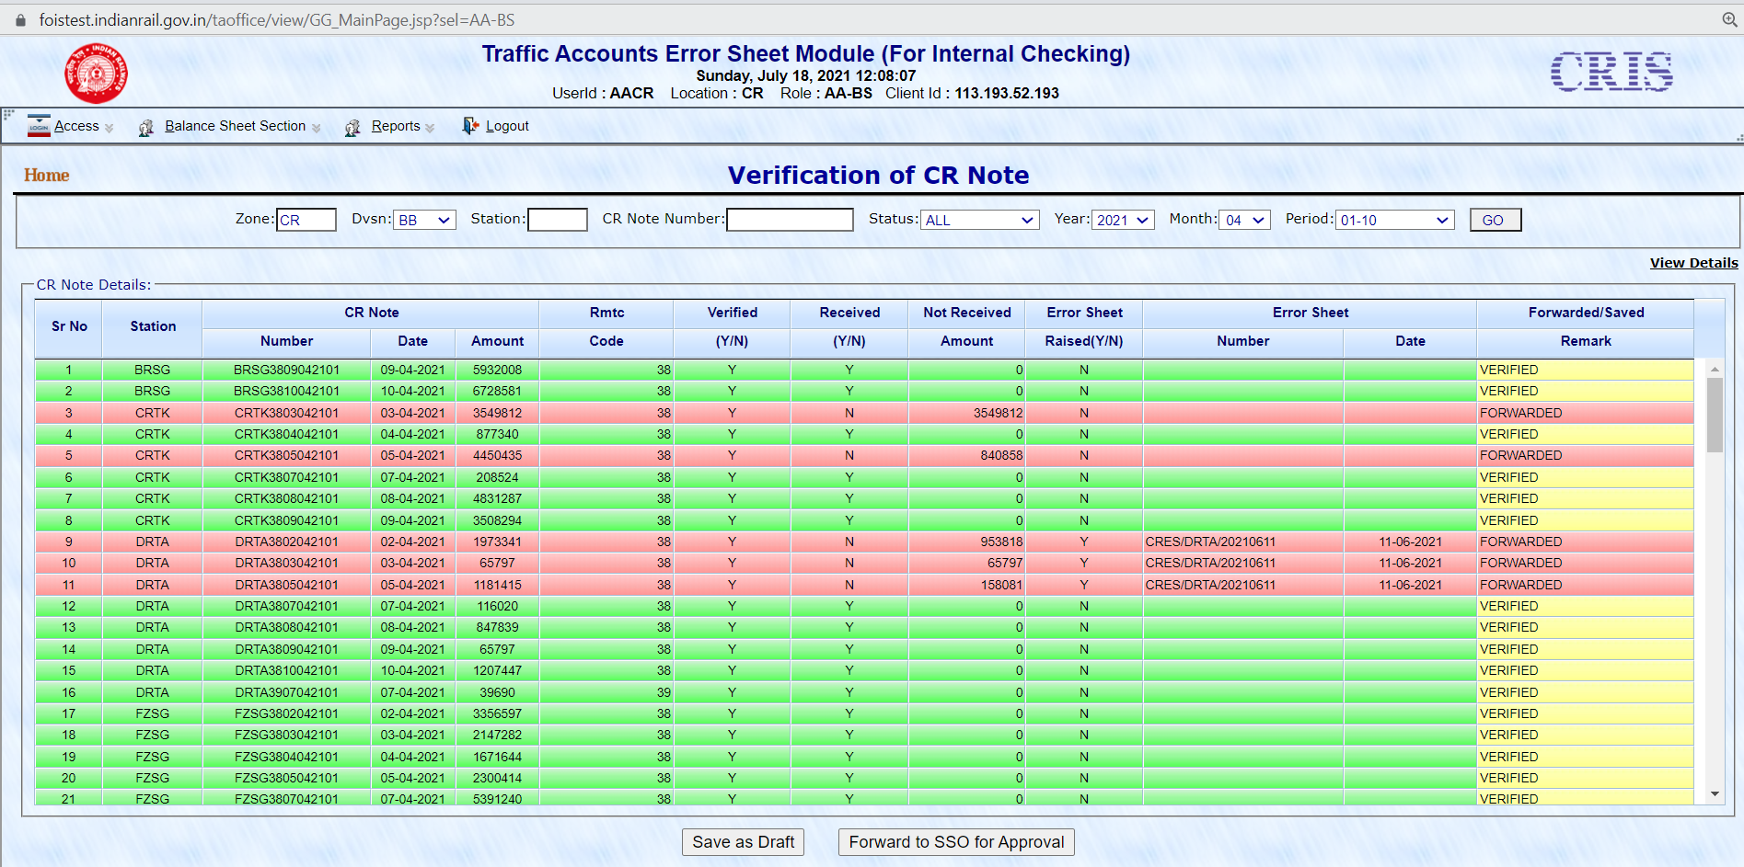
Errorsheet Module in FOIS
BACK

Slide 39
AOB Module
Voucher data from PRS UTS
Voucher data from IPAS
TAMS
Automated
Reconciliation
Unmatched
IPAS Data checked & matched manually
Matched
Internal Check
Auto bill generation
Notes:
Exception reports will be generated automatically for the non-matching.

Slide 40
TIA module
To have effective planning & Control over Inspection Process
To have better monitoring on the due & Over due Inspections
To include flexibility through built in mechanism for Special Check, Assistance to TIAs, allotment of inspection.
Paperless reporting System (except TA 6F)
Online verification of reports and closure.

Slide 41
THANK YOU

