Slide 1

All about Railway Pension
Module 3
INDIAN RAILWAYS INSTITUTE OF FINANCIAL MANAGEMENT
Niketan Sahoo
Sr. AFA (Pension), Western Railway

Slide 2
Settlement process flow
Pension sanctioning authority
(Personnel)
PPO issuing authority
(Accounts)
Sanction
Settlement
Dues
  Regulating Bodies
  G.O.I (DOP&PW)
  Railway Board
  MOF (dep of expenditure)
  Reserve Bank of India
  Parent Organisation
PPO
Pension Payment Order
Pension disbursing authority
(Bank)
Pensioner
Credit to account
Life certificate
Direct credit to employee’s savings bank account through NEFT

Slide 3
Pension payment cycle sanction- disbursement- accountal
PPO issuing Auth(Railway)
FA&CAO(pension)
PPO
Bank CPPC
(Centralised Pension Processing Centre)
scrolls
eSCROLL
RBI raises debit to railways
Reconciliation
KYC
PPO
RBI
CAS/NGP
focal /nodal branch
paying branch
Re-imbursement by RBI to Banks
Pensioner’s Account
Paid vouchers
Payment

Slide 4
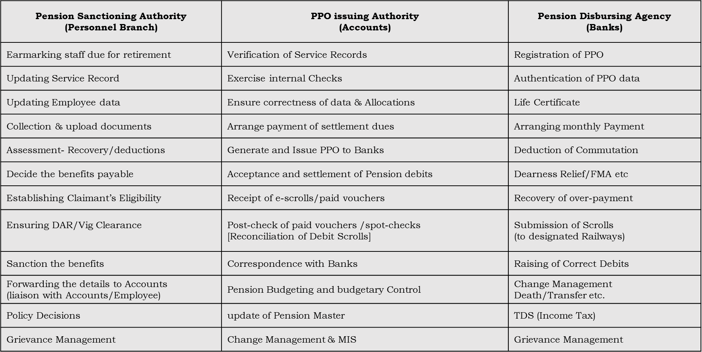
Authorities involved in settlement/pension process : duties, responsibilities

Slide 5
FA&CAOs designated for accepting pension debits from RBI
Designated FA&CAO | States/UTs covered | Designated FA&CAO | States/UTs covered
CR | Maharashtra | NWR | Rajasthan
ER | West Bengal | SCR | AP and Telangana
ECR | Bihar | SECR | Chhattisgarh
ECoR | Odisha | SER | Jharkhand
NER | Uttarakhand | SR | T.N., Kerala, Puducherry
NEFR | Assam and NE states | SWR | Karnataka, Goa
NR | Delhi, Punjab, Haryana, HR, J&K, Ladakh | WCR | Madhya Pradesh
NCR | Uttar Pradesh | WR | Gujarat, Daman
What does ‘designated FA&CAO’ mean?
Say, an employee retires from Hyderabad in South Central Railway but opts to draw pension at Tambaram, Chennai of Southern Railway, the designated F&CAO in the employee’s case shall be that of Southern Railway. The employee’s PPO will be issued by SCR but the e-scrolls pertaining to her pension disbursement will be generated by SBI, CPPC, Chennai favouring Southern Railway. The responsibility of accepting and settling debit raised by the bank through RBI will rest with FA&CAO (Pension) SR.

Slide 6
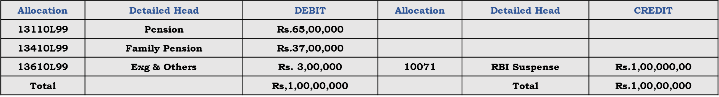
How do railways make book adjustment of Pension debits?
After disbursement of pension to retired employees, banks submit re-imbursement claims to the RBI.
RBI debits Government Account and credits the debit-raising bank’s Account.
RBI raises debit on the designated FA&CAO.
On receipt of debit advice from RBI, the designated FA&CAO makes this adjustment :
Debit to RBI Suspense and Credit to RBI Deposit through Adjustment Journal Voucher as follows :
Adjustment JV prepared by designated FA&CAO (books)
Thus, on receipt of RBI’s debit scrolls, RBI suspense gets cleared by FA&CAO (pension) with booking of the expenditure to Final Heads of Pension (Demand 13)
Adjustment JV prepared by FA&CAO(Pension)
Note : RBI Suspense gets cleared on monthly basis and nullified in March at the end of the financial year.
Allocation | Detailed Head | DEBIT | Allocation | Detailed Head | CREDIT
00866079 | RBI Suspense | Rs,1,00,00,000 | 00867504 | RBI Deposit | Rs. 1,00,00,000
Rs. 60,00,000
0086679

Slide 7
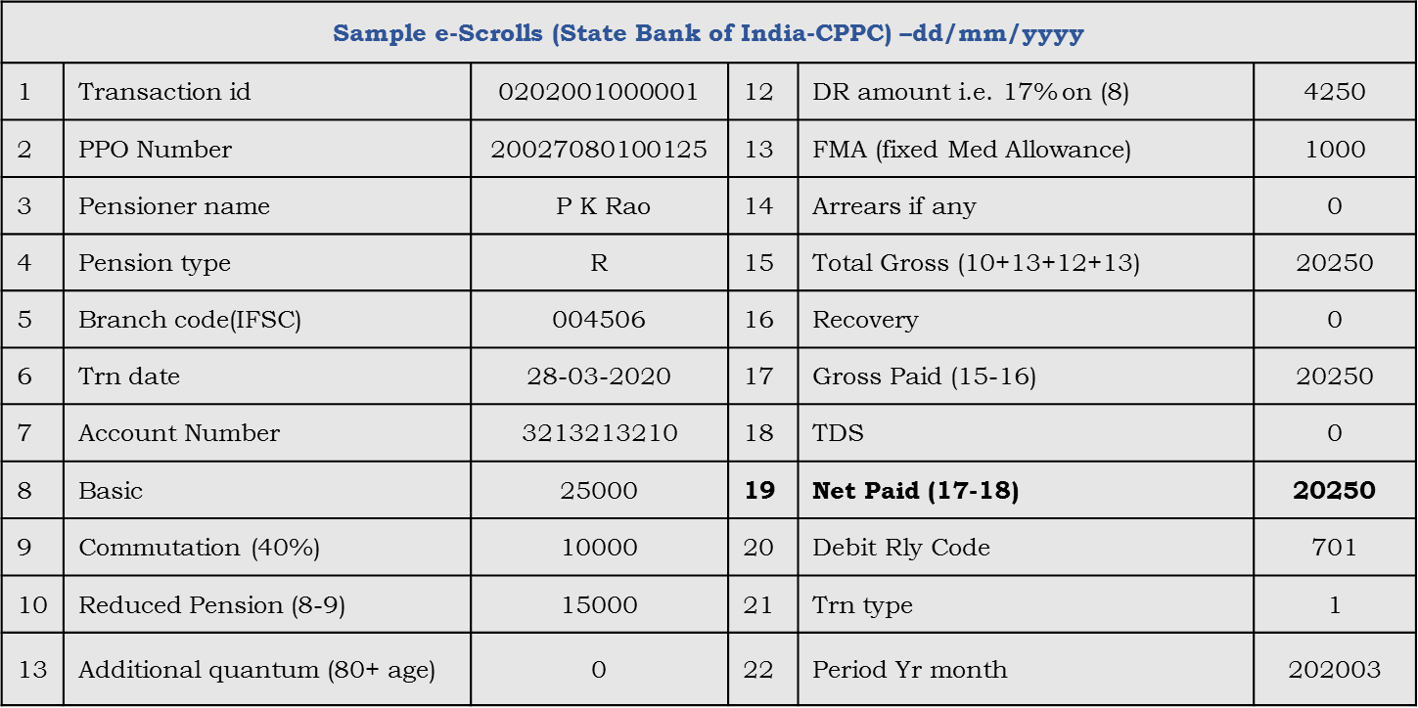
Pension debits scrolls
After monthly payment of pension, banks sends e-Scrolls to Railways as token of paid vouchers.
The scrolls are submitted to Railway by CPPC of the bank in a tabular format with details of multiple pensioners to whom payments were made during a given period. These are the details the scroll carries :

Slide 8
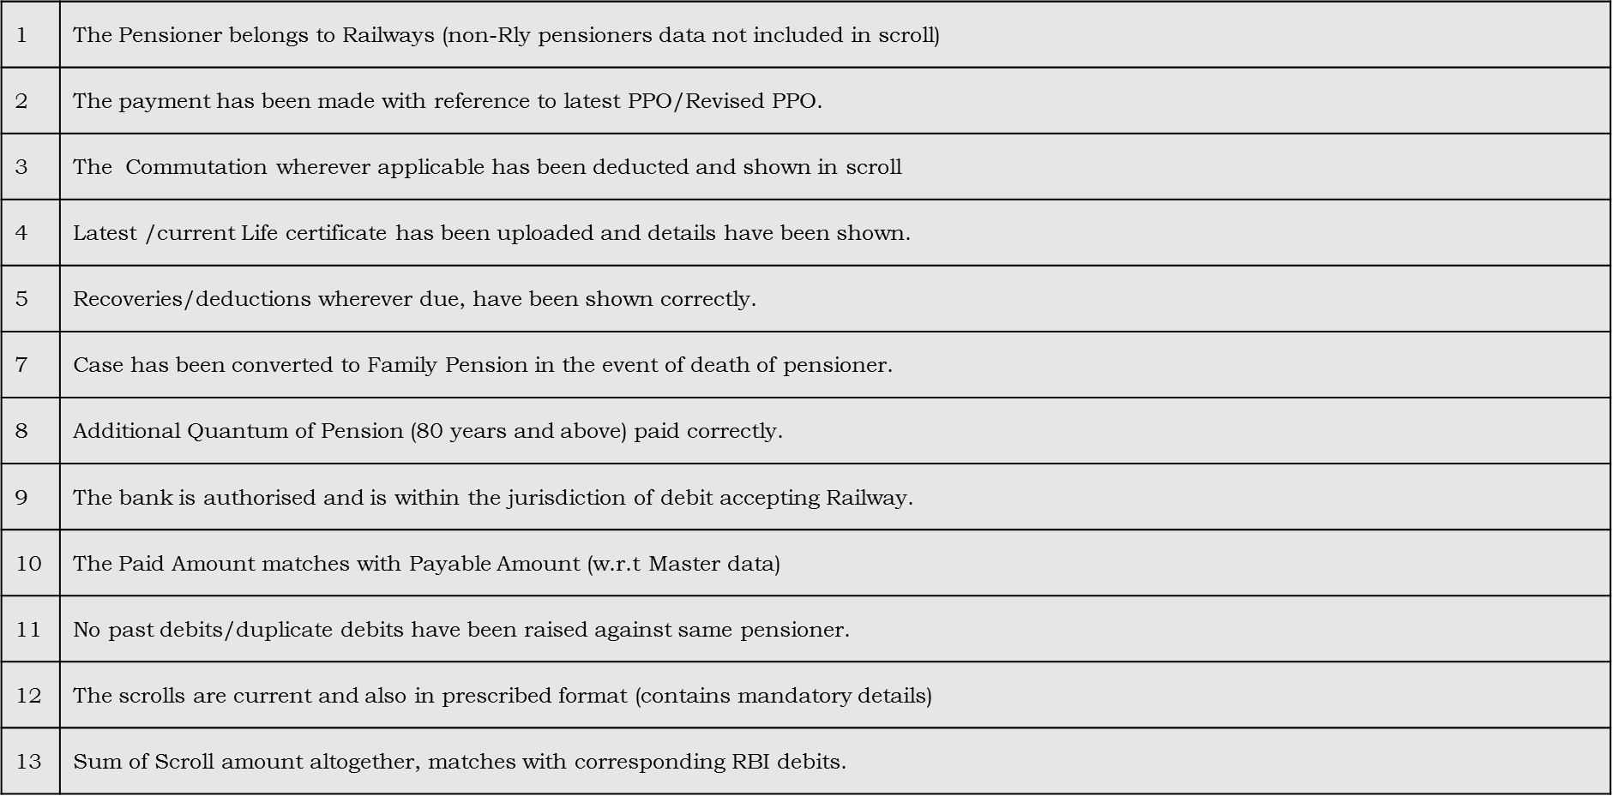
Reconciliation/post-check of pension debit scrolls process flow

Slide 9
Appropriation Account (pension) demand 13, importance of
Preparation of Appropriation Account for Demand 13 is mandatory after closing of the FY to comply with:
Constitutional obligation ; compliance with C&AG’s audit.
Parliament Reform Committee
For budgeting
For planning, future reforms
Railways are liable to justify the actual expenditure incurred, whether saving or excess.
Deduct Entry in Pension Fund (Demand 14) : Adjustment with Liability incurred under Demand 13

Slide 10
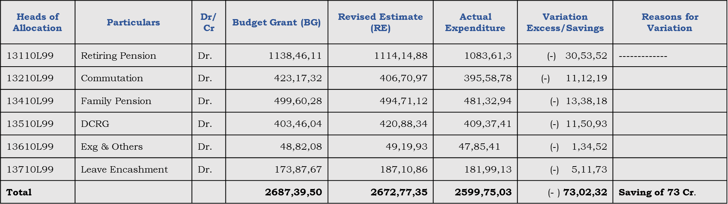
Appropriation Account (pension) Demand 13 FY 2019-20
A specimen
Rupees in 000

Slide 11
Thank You

