Slide 1

All about Railway Pension
Module 1
INDIAN RAILWAYS INSTITUTE OF FINANCIAL MANAGEMENT
Niketan Sahoo
Sr. AFA (Pension), Western Railway

Slide 2
What is pension?
The word Pension comes from pensiō, Latin for payment.
It is a fund into which a sum of money is added periodically during an employee's employment years.
Payments are then drawn from the fund periodically to support the employee’s financial security after the employee’s retirement from work.
Pension can be Contributory or Non-Contributory one.
Let us see what kinds of pension are out there:

Slide 3
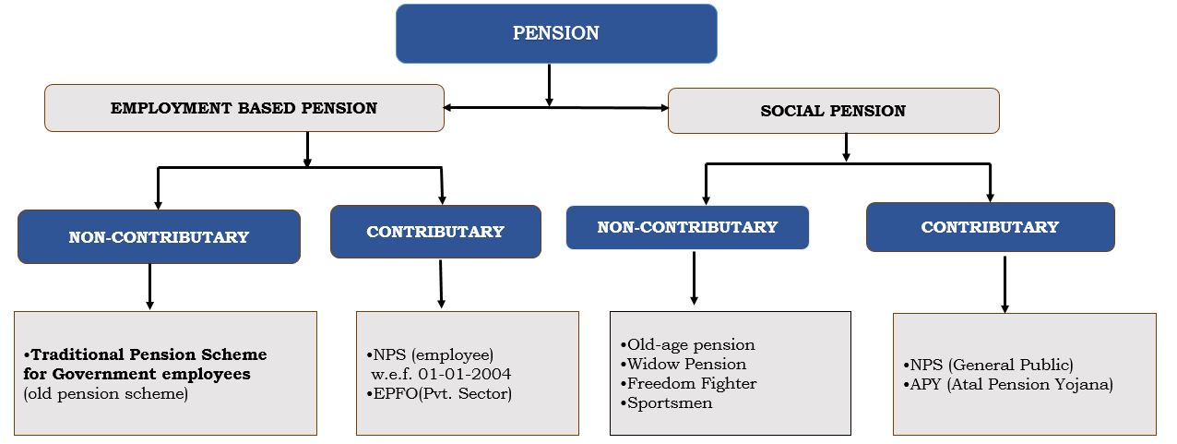

Slide 4
What kind of pension applies to Indian Railways?
Indian Railway employees are Central Government Employees. They enjoy benefits of wages and pension at par with Central Government employees and pensioners.
Railway Pension is governed by Railway Service (Pension) Rule which comprises CCS (Pension) Rules and Orders issued by the Department of Pension & Pensioners welfare (DOP&PW) as well as Railway Board from time to time.
But for employees inducted into rail service post 2004 who fall under NPS, pension scheme concerning majority railway employees in Indian Railways is largely non-contributory in nature.

Slide 5
Pension in Indian Railways
Indian Railways (IR) are a Commercial Organization. They earn revenue by selling transport services.
IR’s finances are based on an accounting system which complies with Government as well as Commercial Accounting norms.
Drawing from the Going Concern concept, being a commercial organization, IR meets all its expenditure from the revenue it earns.
IR’s staff cost and pension liability are thus met out of the revenue it receives (Net Traffic Receipt).
Being a commercial undertaking, IR created a Pension Fund to meet its future pension liability. The concept of Fund is now obsolete as IR is barely able to bear the huge incremental burden of pension pay-outs.
In fact, IR is required to contribute annually to its Pension Fund an actuarially estimated amount. Why? So that the balance in the fund accurately reflects the amount paid in a given year as well as potential cumulative liability for employees’ pension benefits earned for each year of service rendered by them.

Slide 6
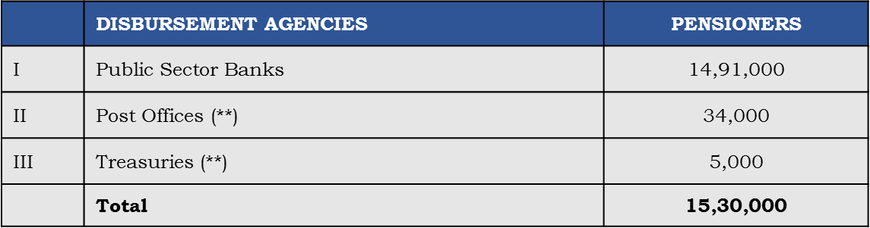
Railway Pension: important statistics
Number of pensioners on 31/03/2020 15,30,000
**Postal/Treasury pensioners are legacy pensioners from 1970s and 80s after which pension is paid only through banks
Bank wise pensioners
PSB | Pensioners | Market Share %
State Bank of India | 7,00,000 | 47%
Other PSBs | 7,90,000 | 53%

Slide 7
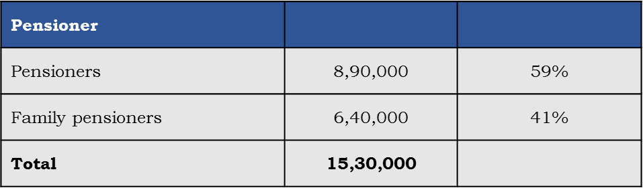
Statistics continued…
age range | number of pensioners | %
<60 years | 1,50,000 | 10%
60-75 years | 9,20,000 | 60%
75-80 years | 3,50,000 | 20%
80-85 years | 1,01,000 | 6%
85-90 years | 40,000 | 3%
90-95 years | 12,000 | 1%
95-100 years | 3,000
Important trends
Average annual retirements : 50,000
Average closure of pension cases : 30,000
Net addition per annum : 20,000

Slide 8
Impact of pension liability on IR : a budgetary overview rupees in crores
Sr. | Particulars | 2014-2015 | 2019-2020 | Increase | % increase | w/o pension scenario
1 | Gross Traffic Receipt | 1,59,248 | 2,16,675 | 57427 | 33%
2 | Miscellaneous Receipts | 4202 | 260
3 | Total Receipts | 1,63,450 | 2,16,935 | 53485 | 33%
4 | Net Ordinary Working Expenses | 1,08,970 | 1,55,000 | 46,030 | 42% | 1,55,000
5 | Appropriation to Pension Fund | 29,225 | 50,000 | 20,775 | 71% | 0
6 | Appropriation to DRF | 7775 | 500 |  |  | 500
7 | Total Working Expenses (4+5+6) | 1,45,970 | 205500 | 59530 | 41% | 155500
8 | Miscellaneous Expenditure | 1028 | 2400
9 | Total Expenditure (7+8) | 1,46,998 | 207900 | 60902 | 41% | 157900
10 | Net Revenue (3-9) | 7278 | 9035 | - | -
11 | Appropriation to DF | 1306 | 1000 | - | -
12 | Appropriation to Capital Fund | 5919 | 3035 | - | -
13 | Appropriation to Railway Safety Fund | 0 | 0 | - | -
14 | Appropriation To Rail Suraksha Kosh | 0 | 5000 | - | -
15 | OPERATING RATIO | 92% | 95% | - | - | 72%

Slide 9
IR’s pension outgo since a decade

Slide 10
Railway Pension : future liability uncertainties and challenges
Railway employees governed under old pension scheme are 11 lakh in number.
Tentatively, the last pre-2004 batch is likely to retire by 2040. Annual pension outgo trend should then start on descending path.
Old pension scheme retirees are set to be added gradually to existing pensioners tally. Even this gradual addition is going to inflate railways’ pension outgo sharply in coming years. Why?
  Due to addition of new pensioners,
  Due to increase in Dearness Relief (twice a year)
  Due to more pensioners entering 80 plus age group with increase in life expectancy; deceased pensioners count to about 60% of new pensioners being added annually
  Due to death cases of employees under NPS being covered under Old Pension Scheme
  Due to family pension benefits having been extended to unmarried/widow/divorced daughters over 25 years old.

Slide 11
Trends in IR’s pension outgo : a hypothetical analysis
This does not include impact of 8th & 9th PCs, if those should be there.

Slide 12
Railway Pension and the Operating Ratio
Zonal Railways are profit centers of which both earnings and revenue expenses are accounted for zone wise. Railways’ Operating Ratio is worked out for each Zonal Railway as also for IR as a whole.
A Zonal Railway’s total working expense also include the total pensionary expenditure incurred by the Railway. Any significant increase in pension outgo without corresponding increase in earning has a reciprocal effect on the Operating Ratio.
Due to rapidly increasing pension expenditure despite growth in reveues, and the resultant higher OR, each passing year leaves less than adequate surplus for IR’s infrastructural development .
Capacity enhancement and optimisation of resources needs assistance by way of deceleration of pensionary outgo. This warrants effective control and time bound reforms.

Slide 13
How IR’s pension liability may be controlled
Pension on IR can neither be scrapped nor dispensed with. However, steps that will aid improvement are:
  Sharing of IR’s pension liability with the Central Government
  Sanitization of legacy data to weed out ghost pensioners.
  Critical review of Dependent Family Pension and Old Age Pension cases.
  Extensive Spot Checks of pension payment in banks, other disbursing units
  Accrual Accounting
  Streamlining the process including debit scrolls’ reconciliation and deployment of robust end-to-end application.
  Watching of recoveries from banks.
  Linking of Pension Accounts with Adhaar details (at par with DBT scheme).
  Rationalisation of jurisdiction of designated FA&CAOs in view of Core Banking System.
  Periodic review of pensioners status through KYP (Know your Pensioner) similar to banks’ KYC.

Slide 14
How Accrual Accounting will help : Understanding potential cumulative liability for pension benefits earned for railway employees for each year of service, not just the present actual liability.
How strengthening Internal Audit (as per Finance Code1) will help : Timely and correct verification of service sheet, promotion, increment, recoveries, deduction, leave record will lead to accurate calculation of Qualifying Service, avoiding any possibility of overpayment.
How a robust application will help : Exhaustive and correct mapping of processes will enable total automation and eliminate need for manual intervention in calculation of QS.
How sanitizing legacy data will help : More than 50,000 PPOs exist for which debits are received by Railways but no railway is able to take ownership of these PPOs. Genuineness of all such PPOs needs urgent verification.

Slide 15
How Spot Checks will help :
IR’s in-house debit reconciliation may not provide 100% accuracy because pension payouts are regulated by externalities such as Life Certificate and its genuineness, marriage/divorce status/nonemployment status of dependents, availability of bonafide physical documents at bank’s end, so forth. These subjective factors can best be verified through spot checks.
At present banks are disbursing addition quantum of Pension/Family pension to more than 1.5 lakh railway pensioners aged 80 years and above . This number is rising rapidly. Age profile of these senior pensioners can best be verified through spot-checks including using video connect.
It may not be practically possible to cover each payment making bank outlet. However, checking 100% pensioners in one specific branch and carrying out varying percentage checks in other branches will minimize scope for misrepresentation of pensioners’ details.

Slide 16
How watching bank recoveries will help :
Instances of overpayment of pension by banks do happen. Recovery of overpayment by bank and remittance of recovery in installments needs to be watched with similar care as adopted by banks in cases of recovery of loans extended by banks to their customers.
How strengthening mechanism of Reconciliation of debit scrolls helps :
Although reconciliation of pension debit scrolls has been automated, it is still not foolproof because legacy data has not been sanitized nor hundred percent revision of PPOs achieved yet.

Slide 17
How PFA wise rationalization of jurisdiction will help :
The extant stipulated jurisdiction of designated FA&CAOs does not give uniformity among railways with reference to their position as PPO issuing railway versus debit accepting railway.
Making each railway/PU liable for acceptance and settlement of pension debits against PPOs actually issued by the railway and not for PPOs issued by other units, especially as online/digital banking system is now the norm, may induce better awareness and responsibility towards this expenditure in the debit bearing railway.
Railway | number of PPOs issued as home rly | number of debits assigned as designated FA&CAO | States covered | debit responsibility index (DRI)
NER | 60,000 | 6,000 | Uttarakhand | - 90%
NCR | 60,000 | 2,50,000 | Uttar Pradesh | + 300%
NR | 1,60,000 | 80,000 | Punjab, Haryana, Delhi, Himachal Pradesh, Jammu, Kashmir | - 50%
WR | 1,35,000 | 75,000 | Gujarat | - 45%
PUs | 45,000 | 0 | all over India | - 100%

Slide 18
Thank you

